Slide 1

CLUSTERS
FOR
GREEN ECONOMY
2017

Slide 2
Improved waste & water
management
Reducing
environmental
risks
Green Economy aims for:
Sustainable development
without degrading the environment
Better
management
of resources
Support for
innovation
Sustainable
production &
consumption
Economic
instruments

Slide 3
WHAT ARE CLUSTERS?
CLUSTER
Interconnected companies
A cluster
is a geographical proximate group of interconnected companies (incl. potential suppliers and associated institutions) in a particular field, linked by commonalities..

Slide 4
LOCAL IMPLEMENTATIONS &
OPPORTUNITIES

Slide 5

WHAT DO THEY FOCUS ON?
CLUSTERS
FOR GREEN ECONOMY
Local rural products
Eco-tourism
Agro-tourism
Organic farming
Better management of resources
Improved water & waste management
Support for innovation
Reducing environmental risks
Sustainable production & consumption
Agriculture
Traditional handicrafts

Slide 6
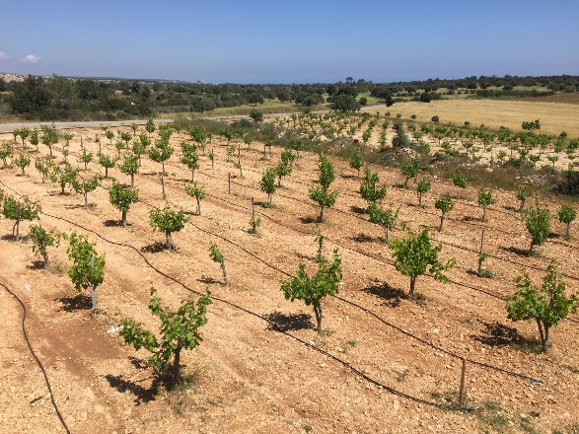
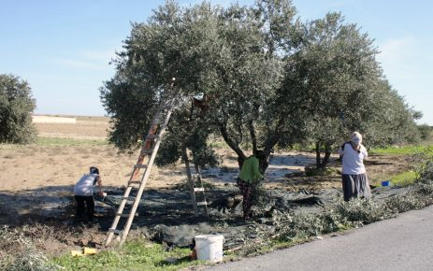
KARPASIA
LOCAL RURAL FOOD PRODUCTS
PILOT CLUSTERS

Slide 7
Sectors
Umbrella Cluster
for marketing, sales & distribution
Olive Cluster
for growing & processing
Grape Cluster
for growing & processing

Slide 8


Olives in TCc
Famagusta; 11%
Trikomo (Karpasia Peninsula); 39%
Morphou; 12%
Nicosia; 12%
182,165 trees
25.5 kg/tree
4645.5 tonnes produce
Kyrenia; 26%

Slide 9


Grape in TCc
Famagusta; 1%
Trikomo (Karpasia Peninsula); 40%
Morphou; 25%
Nicosia; 1%
544 donums area
192.5 tonnes produce
Kyrenia; 33%

Slide 10
Capacities of the Olive Mills
Activities | Mill 1 | Mill 2 | Mill 3 | Mill 4
Burun oil processing | - | - | 80 | 80
Traditional stone mill processing | - | 768 | 768 | 768
Modern oil processing | 3840 | 1440 | 960 | -
Table olive processing | 200 | - | - | -
Table olive packaging labelling | 200 | - | - | -
Olive oil bottling / labelling | 3840 | 960 | - | -
Cold storage | 120 m² | - | - | -
ISO 9002 Certificate | Yes | Yes | No | No
ISO 22000 Certificate | Yes | Yes | No | No

Slide 11
Analyses Necessary to Ensure Quality (Olives)
Products | Analyses necessary
Olives | Pesticide residue analysis necessary for olive fruits. Public laboratory cannot do it now, but they have an equipment and information, they needs to study the method of the analyses.
Cold pressed olive oil | Below mentioned analyses are necessary for cold pressed olive oil. A few of them, indicated in red and italic, can be done by the public laboratory; 1. Quality Criteria 1.1. Free acidity (% oleic acid), 1.2. Peroxide value (meq active oxygen/kg fat), 1.3. UV light specific absorption (E) ⁽⁴⁾, E (232 nm), E (270 nm), Delta E, 1.4. Fatty acid Ethyl Ester (FAEE) (mg/kg), 1.5. Halogen solvents, 2. Purity Criterias 2.1. gas chromatography method, composition of fatty acids (% m/m Methyl Esters), Myristic acid (C14:0), Palmitic asit (C16:0), Palmitoleic acid (C16:1), Heptadecanoic/ margaric acid (C17:0), Heptadesenoic/ margoleic acid (C17:1), Stearic acid (C18:0), Oleic acid (C18:1), Linoleic acid, (C18:2), Linolenic acid (C18:3), Aracidic acid (C20:0), Gadoleic/ eikosenoic acid (C20:1), Behenic acid (C22:0), Lignoseric acid (C24:0), 2.2. 2-gliseril monopalmitat (%), 2.2.1. Total Palmitic acid (%) ≤ 14, 2.2.2. Total Palmitic acid (%) > 14, 2.3. Sterol Composition^{(4),} 2.3.1. Total Sterol %, Colesterol, Brassikasterol, Kampesterol, Stigmasterol Delta-7-stigmastenol, Σ Beta-sitosterol, (Beta-sitosterol + delta-5-avenasterol + delta-5,23-stigmastadienol + klerosterol + sitostanol + delta-5,24-stigmastadienol), 2.3.2. Total Sterol, (mg/kg), 2.4. Eritrodiol and Uvaol (in total sterols), (%), 2.5. Trans Fatty acids, C 18:1T (%), C18:2 T (%)+C 18:3 T (%), 2.6. Seed soil determination, real and theoric ECN 42, max. variation in triacylglyceride coverage 2.7. Determination of refined vegetable oil, Stigmastadiens (mg/kg), 2.8. Waxy items (mg/kg)
Table olives | Salt content, ph value, ferroguluconate or ferrolactad amount, acidity content (lactic acid), sorbate content (sorbic acid), benzoat content (benzoic acid), cadmium content (Cd),

Slide 12
Analyses Necessary to Ensure Quality (Grapes)
Products | Analyses necessary
Grapes | Pesticide residue analysis necessary for grapes, it can be done by the public laboratory
Köfter and sucuk | Total dry matter content, moisture content, total acidity, raw fibre, fat yağ, total ash, protein, sugar, identification of invert sugar, amount, according to AOAC (2000). Hidroksimetilfurfural (HMF) amount. Köfter thickneses identified by milimitric compass. Total aflatoxine amount and aflatoxine Bl content.
Zivania | Ethyl alcohol, total dry matter, Methanol, Aldehide, Ester, Higher alcohols, Anetol, Density, Acetic acid
Preserved vine leaves | Salt content, (%m/m), sorbat content (sorbic acid), benzoat content (benzoic acid), sulphur dioxide content, pesticide residue analysis.

Slide 13
Olive & Grape - SWOT Analysis
STRENGTHS
Existence of favourable natural conditions for olive and grape production,
The importance of the olive and grape products for the region and TCc,
Existence of a labour force, experienced in the production of traditional products,
Feasible natural environment for organic agricultural activities,
Existence of universities to educate qualified human resources,
Production areas closely located to each other.

Slide 14
Olive & Grape - SWOT Analysis
WEAKNESSES
Decreasing number of people involved in agricultural activities,
The use of primitive agricultural methods in some areas,
Disorderly plantation, inexistence of variety standardisation,
Insufficient use of quality seeds and technology,
Lack of modern and specialised olive gardens,
Lack of standards, marketing and branding,
Insufficient storage facilities and packaging,
Lack of cooperation between the producers,
Logistic problems - high transportation cost,
Lack of value added products,
No professional management,
Misuse of pesticides and increase in chemical waste,
Lack of pruning, degenerated fruits from pruning mistakes, periodicity from harvesting mistakes,
Lack of resistance against diseases and pests,
High acidity due to the mixing of olives harvested from the tree with those that fall on the ground

Slide 15
Olive & Grape - SWOT Analysis
OPPORTUNITIES
Elimination of the water problem in the TCc by the water project, will increase the yield and production of areas and thus income will increase,
Increase in the varieties of products,
Increase in the use of agricultural products to make value added products,
Utilizing the demand for traditional foods and products by intensified marketing all over TCc,
The eco and agro tourism potential of the region and the increase in these activities,
Increase marketing activities of processed products to touristic places and cultural activities and festivals,
Transforming individual home producers into established companies and produce the products according to the international quality standards.

Slide 16
Olive & Grape - SWOT Analysis
THREATS
Political instabilities and land ownership issue,
Lack of subsidy policies, such as the encouragement of modern olive gardens, vineyards and organic production, providing of suitable mechanisation tools, renewal of the sector’s equipment and processing the waste fluids, allowance import, protection of local varieties,
Lack of laboratory services for testing and incompliance of the current TCc olive oil regulations with the EU acquis,
Decrease in the numbers of the younger generation active in agriculture as a result of migration,
Ever-increasing external competitiveness,
Decrease in the agricultural fields and water sources, spoiling of the natural environment and the increase in waste due to increasing tourism activities in the region (as there is no processing done on the waste fluids from the facilities, these fluids cause serious soil and water pollution),
Gradual depletion of the current water sources.

Slide 17
Issues to be addressed by the clusters
Clustering will address the following issues identified in the industry analysis:
  Lack of standardisation
  Lack of quality assurance
  Lack of institutionalisation
  Lack of professional management
  Lack of branding
  Lack of linkages

Slide 18
Olive Cluster
Area
Büyükkonuk/ Komi Kepir Township including 6 villages
Target Group
50 olive growers
Growth Potential
200 olive growers
Annual capacity of 600 tonnes
Annual capacity of 2400 tonnes
Main activities
Growing
Processing

Slide 19
Grape Cluster
Area
Mehmetcik/ Galateia Township including 5 villages
Target Group
40 grape growers
200 tonnes annual capacity
Growth Potential
110 grape growers
550 tonnes annual capacity
Main activities
Growing
Processing

Slide 20



Umbrella Cluster
Sales
Logistics
Export
Marketing
Quality Control
Cold Storage
Branding
A common cluster will be established by the Chamber of Shopkeepers and Artisans as an umbrella cluster which would provide common services to the production clusters.

Slide 21
Legal Structure
LTD. Company
Cooperative
Olive and grape cluster participants have agreed on the principles of a cooperative as the legal status of the production clusters

Slide 22
Specific Fields of Cooperation
GRAPE CLUSTER
1. Production
(Pruning, soil cultivation, fertilizing
irrigation system, pest, weed
and disease control, harvesting)
2. Processing
3. Packaging
OUTSOURCING
2. Processing
3. Packaging
UMBRELLA CLUSTER
1. Common Cold storage
2. Marketing & Branding activities
3. Sales & Distribution activities
OLIVE CLUSTER
1. Production
(Pruning, soil cultivation,
fertilizing, irrigation system
Pest, weed and disease
control, harvesting)

Slide 23
Olive Cluster Products
Burun oil
(English 'flower of the oil', French 'fleur d'huile')
Olive Oil
Cold pressed extra virgin olive oil
Table Olives

Slide 24
Grape Cluster Products
Vine Leaves
Zivania
Sucuk
Köfter
Fresh Grapes

Slide 25
OUR STRATEGY TO INCREASE EFFICIENCY

Slide 26
Strategy to Improve Clusters’ Productivity
Clusters’ Productivity
Enchasing co-operation between producers
To set up a system of purchases for input materials and services
Supporting GLOBALGAP certification process
To obtain GLOBALGAP certification for producers
Improving agricultural practices used by producers
To decrease the cost of input materials and services
To decrease the cost of the GLOBALGAP certification
To generate interest in GLOBALGAP certification
To organise a training on best pruning techniques
To arrange a seminar on application of pesticides
To assemble a workshop on QMS and food safety
Benefiting from circular economy
Feasibility study on usage of waste material

Slide 27
Marketing Objectives
( In 5 years)
Financial Goals
Increase revenues by at least 200%
To achieve critical mass after 5 years of operation
Non-financial Goals
Build strong brand awareness for the two product groups
Increase number of producers attracted to the production clusters as a result of proven success of the umbrella cluster
25 New olive producers each year
Establish a web presence
10 New grape producers each year

Slide 28


  Branding and Marketing Strategy
Brand architecture: choosing the most appropriate brand architecture scenario
  Scenario 1: One common brand is created for all clusters;
  Scenario 2: Separate brands are created for each cluster;
  Scenario 3: Brands are created for each product)
Choosing a positioning strategy
  To choose positioning and naming strategy
  To generate name for the brand(s)

Slide 29






Marketing Promotion
Advertisements
TV Ads | Web & Social Media Ads | Newspaper Ads
Public Relations Direct Marketing Sales Promotion
Interviews/ Editorials | Customer Visits | Tasting Sessions

Slide 30
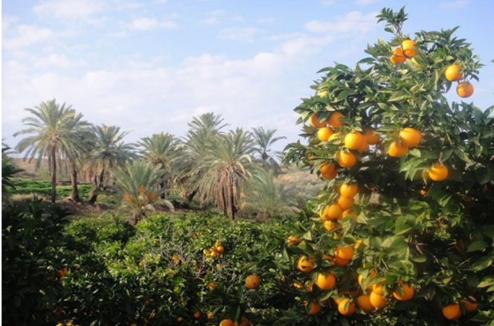
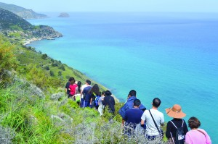
ECO and RURAL TOURISM
CLUSTER IN LEFKE/LEFKA

Slide 31
Local Conditions on Tourism
Places to See
25 Historical sites and landmarks
Accommodation
7 Eco-tourism accommodations with 175 bed capacity
Restaurants & Cafes
22 Restaurants
6 Cafe & bars
5 Alternative
Other Tourism Related Businesses
3 Travel agency
3 Rent-a-car companies
4 Taxi companies
1 Exchange Office
4 Florists

Slide 32
Lefke Eco & Rural Tourism Cluster
Area
Lefke/ Lefka Township including 12 villages
Target Group
56 members from various sectors in the region
Growth Potential
Additional 50 members from related sectors
Main activities
Adoption of quality standards
Development of new products and services
Capacity development
Networking
Marketing/ Promotion

Slide 33
Legal Structure and Approach
Non-profit NGO
Generating revenues only for covering expenses of common activities, not commercial.
Lefke Eco and Rural Tourism Cluster
Common Activities
Benefits from Activities
Restaurants
Hotels
Local producers
Travel Agencies
Other tourism sub-sectors

Slide 34
Specific Fields of Cooperation
Marketing/ Promotion
Capacity development
Adoption of quality standards
Development of new products and services
Networking

Slide 35
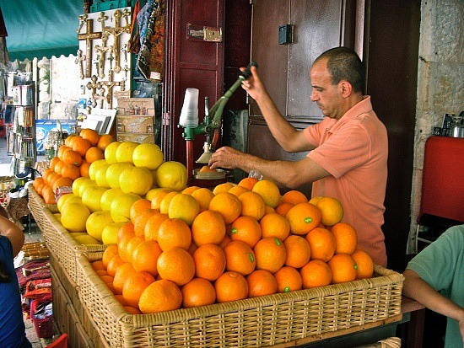
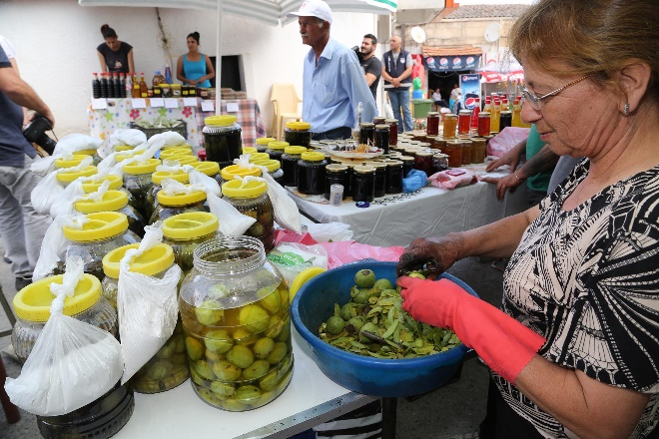
LEFKE
AGRICULTURE, HANDICRAFTS
AND TOURISM CLUSTER

Slide 36
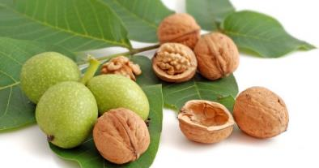
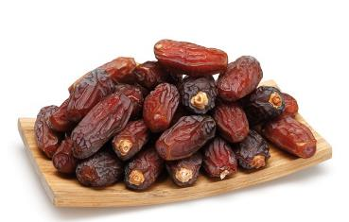
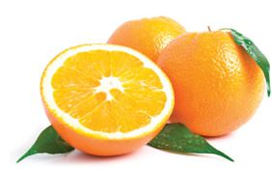
Local Conditions
Most important agricultural products:
  Citrus Fruits
  Walnuts
  Dates
  Strawberries

Slide 37
Lefke Local Products Cluster
Area
Lefke/ Lefka Township including 12 villages
Target Group
50 farmers and handicrafts producers
Growth Potential
Additional 50 members
450 tonnes citrus
6 tonnes walnut
Main activities
Marketing/ Sales
Distribution
Processing
Training
Cafe Services
Producing

Slide 38
Legal Structure
LTD. Company
Cooperative
Lefke/ Lefka local products cluster’s established legal structure is a non-profit cooperative

Slide 39
Specific Fields of Cooperation
Macun processing
Producing handicrafts
Training
Cafe services
Horizontal part
Vertical part
Storage, Distribution
Branding, Marketing, Sales

Slide 40
Lefke/Lefka Cluster Products & Services
Macun
(Walnut, bitter orange, date)
Traditional Handicrafts
Dried Citrus
Trainings
Cafe services

Slide 41
Thank you

