Slide 1
Introduction to
Grant Project Development
Vesna Vertovsek, October, 2017

Slide 2
Starting the project development
Reading the Call for proposals – you have been developed project ideas which should be improved in order to elaborate a sound project proposal which meet all the objectives in the framework of the Call.
Tailor-made applications are requested which meet the special needs of the target groups.
Therefore we would like to start with a short course in project development.

Slide 3
What is a Project ????
-A specific not an usual everyday activity;
-project has specific objectives(or goals) to achieve;
  -requires resources;
  -has budget;
  -and limited timeframe;
  -project requires the effort of people

Slide 4



relevant
Project has to be
feasible
sustainable
Relevance relates to whether the project addresses the real problems of the intended beneficiaries
Feasibility relates to whether the project objectives can be effectively achieved
Sustainability relates to whether project benefits will continue to flow after the external assistance has ended.

Slide 5
The Project Cycle
Identification
Grant Project Development
Monitoring&Evaluation
Analysis
Implementation
Formulation
Financing
Call for Proposals
Full AF
Business plan
Conncept Note

Slide 6
Project Cycle Management
is a methodology for the preparation, implementation and evaluation of projects based on the principles of the logical framework approach (LFA)
describes management activities and decision-making procedures used during the life cycle of a project
  Key tasks
  Roles and responsibilities
  Key documents and decision options

Slide 7
Logical Framework Approach

Slide 8
Logical Framework Approach
Technique to set up a project involving the identification of problems, prioritisation of objectives*, definition of results and related activities through a careful consideration of the means, success indicators and assumptions.
* See the problem tree
LFA is a key management tool in each phase of the project cycle: from implementation to evaluation, representing a «master tool» for creating other tools (e.g. implementation and resource schedules, monitoring plan, etc.)

Slide 9
2. The project design logic
PROJECT
“Who`s affarid of the wolf?”
RESULT
OBJECTIVE
The target hit
To kill the wolf
ACTIVITY
Shoot the arrow
GENARAL OBJECTIVE
Save the sheep and increase the farmers' earnings

Slide 10
Logical Framework
Approach (LFA)
is an analytical process (involving stakeholder analysis, problem analysis, objective setting and strategy selection)
Logical Framework
Matrix (LFM)
provides the documented product of the analytical process (while requiring further analysis of objectives, how they will be achieved and potential risks)

Slide 11
Drowing up a logframe: Analysis
Drawing up a Logframe has two main stages, Analysis and Planning, which are carried out progressively during the Identification and Formulation phases of the project cycle:
There are four main elements of the Analysis Stage, namely:
1. Stakeholder Analysis, including preliminary institutional capacity assessment, gender analysis and needs of other vulnerable groups such as the disabled (profile of the main ‘players’);
2. Problem Analysis (profile of the main problems including cause and effect relationships);
3. Analysis of Objectives (image of an improved situation in the future); and
4. Analysis of Strategies (comparison of different options to address a given situation).
This analysis should be carried out as an iterative learning process, rather than as a simple set of linear ‘steps’. For example, while stakeholder analysis must be carried out early in the process, it must be reviewed and refined as new questions are asked and new information comes to light.

Slide 12
Stakeholder analysis
Stakeholders - those who are influenced by and exert an influence on the project entity
Mapping of stakeholders and their respective roles
Who will be influenced, positively or negatively, by the project
Which stakeholders should be involved in planning and/or implementing the Project.

Slide 13
Stakeholder analysis
Purpose:
To identify:
  The needs and interest of stakeholders
  The organizations, groups that should be encouraged to participate in different stages of the project;
  Potential risks that could put at risk project/programme;
  Opportunities in implementing a project/programme;
To assess the performance and capacity of the participating units, divisions of organization.
Each participating unit has to undertake SWOT analysis

Slide 14
Stakeholders: Individuals or institutions that may – directly or indirectly, positively or negatively – affect or be affected by a project or programme.
Beneficiary: The applicant
Target group(s): The group/entity who will be directly positively affected by the project at the Project Purpose level.
Final beneficiaries: Those who benefit from the project in the long term at the level of the society or sector at large, e.g. “children” due to increased spending on health and education, “consumers” due to improved agricultural production / marketing.
Project partners: Those who implement the projects in-country (who are also stakeholders, and may be a ‘target group’).

Slide 15
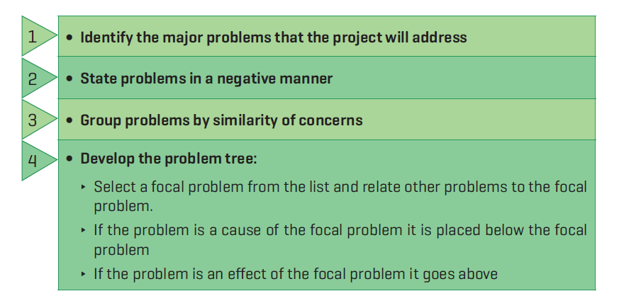
Problem Analysis

Slide 16
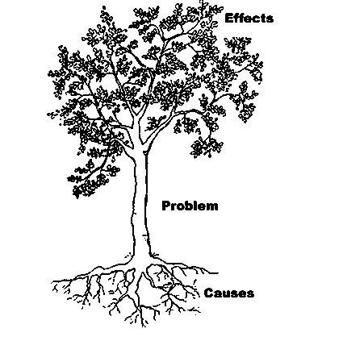
Exercise

Slide 17
Drowing up a logframe: Planning Analysis
In the Planning Stage the results of the analysis are transcribed into a practical, operational plan ready to be implemented. In this stage:
• the logframe matrix is prepared, requiring further analysis and refinement of ideas;
• activities and resource requirements are defined and scheduled, and
• a budget is prepared.
This is again an iterative process, as it may be necessary to review and revise the scope of project activities and expected results once the resource implications and budget become clearer.

Slide 18
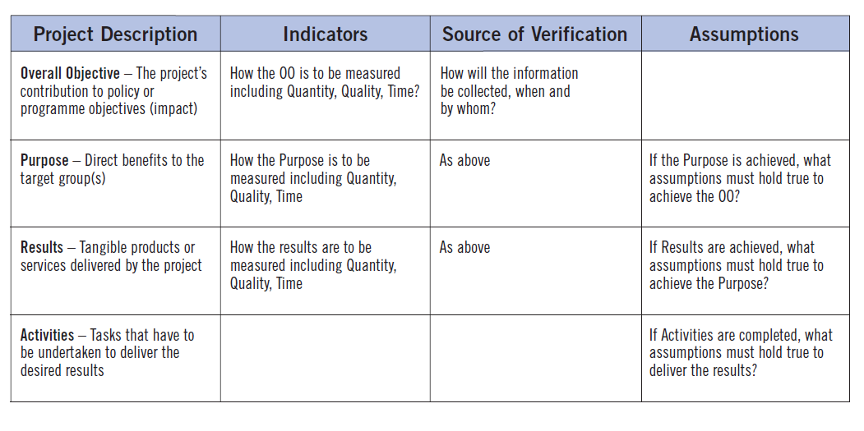
Typical structure of a Logframe Matrix*
*Project Cyclus Management Guidelies

Slide 19
Terminology
Specific objective = purpose
Results = outputs

Slide 20
The First Column: Intervention Logic
If-then causality
The first column of the Logframe matrix summarises the ‘means-end’ logic of the proposed project (also known as the ‘intervention logic’).
When the objective hierarchy is read from the bottom up, it can be expressed in terms of:

Slide 21
The First Column: Intervention Logic
IF adequate inputs/resources are provided, THEN activities can be undertaken;
IF the activities are undertaken, THEN results can be produced;
IF results are produced, THEN the purpose will be achieved; and
IF the purpose is achieved, THEN this should contribute towards the overall objective.
or

Slide 22
The First Column: Intervention Logic
IF we wish to contribute to the overall objective, THEN we must achieve the purpose
IF we wish to achieve the purpose, THEN we must deliver the specified results
IF we wish to deliver the results, THEN the specified activities must be implemented; and
IF we wish to implement the specified activities, THEN we must apply identified inputs/resources.

Slide 23
Fourth Column: Assumptions
Assumptions are external factors that have the potential to influence (or even determine) the success of a project, but lie outside the direct control of project managers. They are the answer to the question: “What external factors may impact on project implementation and the long-term sustainability of benefits, but are outside project management’s control?”

Slide 24
Fourth Column: Assumptions
The assumptions are part of the vertical logic in the logframe. This works as follows:
• once the Activities have been carried out, and if the Assumptions at this level hold true, results will be achieved;
once these Results and the Assumptions at this level are fulfilled, the Project Purpose will be achieved; and
• once the Purpose has been achieved and the Assumptions at this level are fulfilled, contribution to the achievement of the Overall Objectives will have been made by the project.

Slide 25
Second and third columns:
Indicators and Source of Verification
Objectively Verifiable Indicators describe the project’s objectives in operationally measurable terms (quantity, quality, time – or QQT). Specifying OVIs helps to check the feasibility of objectives and helps form the basis of the project’s monitoring and
evaluation system.

Slide 26
Second and third columns:
Indicators and Source of Verification
The source of verification should be considered and specified at the same time as the formulation of indicators. This will help to test whether or not the
Indicators can be realistically measured at the expense
of a reasonable amount of time, money and effort.
The SOV should specify:
• How the information should be collected (e.g
from administrative records, special studies, sample surveys, observation, etc ) and/or the available documented source (e.g. progress reports, project accounts, official statistics, engineering completion certificates etc.)

Slide 27
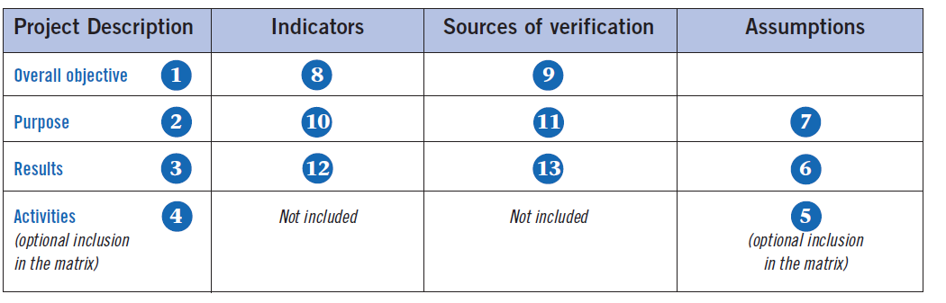
Sequence of completion*
*Project Cyclus Management Guidelies

Slide 28
Sequence of completion
The preparation of a Logframe matrix is an iterative
process, not a just a linear set of steps. As new parts
of the matrix are drafted, information previously
assembled needs to be reviewed and, if required,
revised.
Nevertheless, there is a general sequence to
completing the matrix, which starts with the project
description (top down), then the assumptions
(bottom-up), followed by the indicators and then
sources of verification (working across).

Slide 29
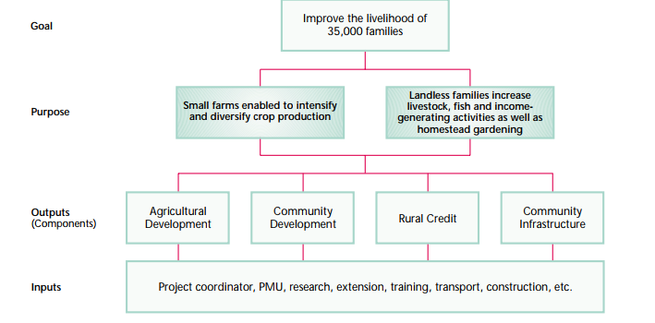

Slide 30
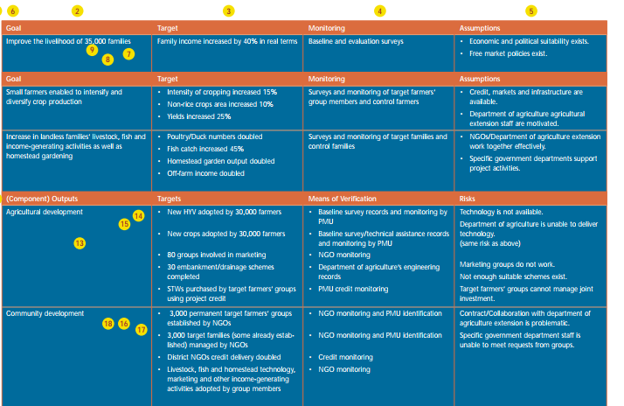

Slide 31
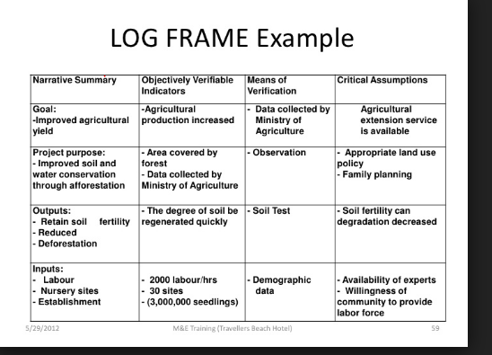

Slide 32
Teşekkürler

