Slide 1
What is an role of ADVISOR
?
Lazo Dimitrov

Slide 2
Expectation and needs
What are your expectations from the training?
What are your expectations from us?
What do you want from us?
Who are we?
Why are we here?
What is our background?
What is our expertise and skills?

Slide 3
Exercise 1. Introduction and background
Expert
Knowledge
CONTENT
Industry
Sector
Area of interest
Specialist
Modest
General
No
Presentation
Lecturing
Mentoring
Solutions
Facilitation
Approach and methods

Slide 4


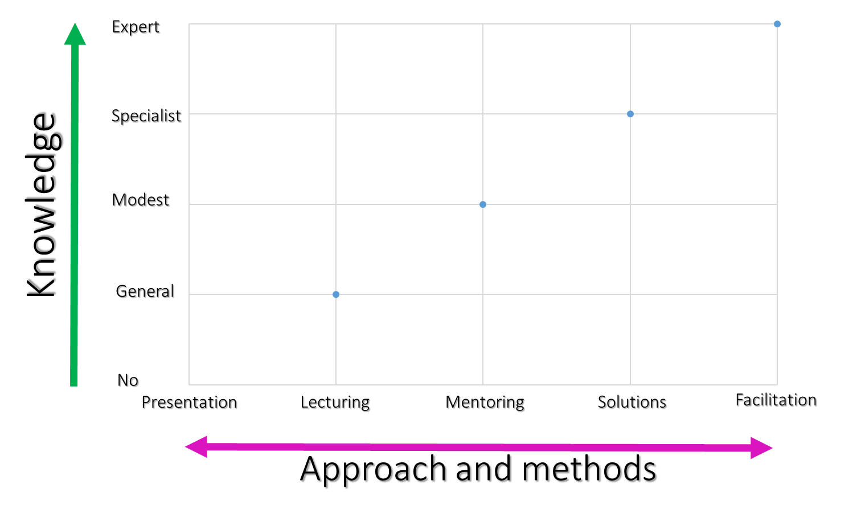

Exercise 1. Introduction and background
Use 5 sticky notes (different color for each sector)
 | Annual crop production
 | Perennial crop production
 | Livestock production
 | Rural business and tourism
 | Finance
Name Surname
1. Write your name and surname
2. Stick to flipchart according your level of knowledge and approach you can use

Slide 5
Or maybe advisor is a farm doctor?
What is advisor?
Is advisor farm engineer?
Is advisor demonstrator?
Is advisor teacher?
Or seller?
Or hired worker?
Or financier?
Or just problem solver?

Slide 6
Types of advisors
Content expert vs Process
Specialist vs Multidisciplinary
Lecturing vs Facilitator
Individual vs Group
Consultant vs Advisor
Sectoral vs General
Public vs Private

Slide 7
Content expert vs Process
Problem solvers
Responsibility
Expert skills
Problem definers
Client involvement
Facilitation skills
Problem focus
Process focus
Expert
Process
Client involvement
Responsibility

Slide 8













Specialist vs Multidisciplinary
Specialist
Multidisciplinary

Slide 9





Lecturing vs Facilitator
Lecturing
Facilitator

Slide 10
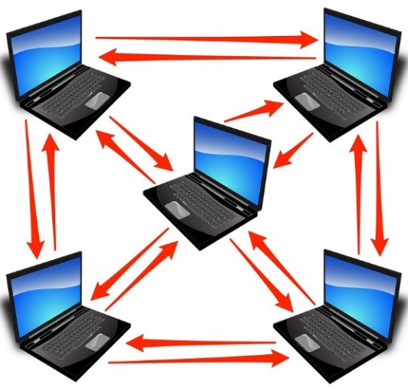
Individual vs Group
Individual
Group
Network

Slide 11
What is an role of advisor?
What is your role as advisor?
What are your expectations as advisor?
What is your background and knowledge?
What experience do you have?
What are the skills you possess?
What is your responsibility?
What is your benefit?
What are your doubts and uncertainty?

