Slide 1

Technical assistance to build the capacity
of the local stakeholders (including business
support organisations) and enhance the competitiveness of the private sector.

Slide 2
METHODOLOGY FOR CLUSTER ANALYSIS, CLUSTER DEVELOPMENT AND SUPPORT POLICIES
WORKSHOP
INTRODUCTION

Slide 3
Project Team
Team Leader: Jean Claude Duplouy
Deputy Team Leader: Giuseppe Nardelli
A pool of around 10 NKEs
Project Assistant: Cansu Tilki
General Information
Starting Date: 27.11.2015
Project Duration: 17 months
Project Address: KOBİGEM Ofisi, Şht. Agah Top Sk. Ortaköy, Nicosia
Tel: +90 392 228 96 44

Slide 4
Components
COMPONENT 1
COMPONENT 2
Feasibility studies, diagnostics & technical support to the three Chambers and other local stakeholders
COMPONENT 3
Communication and visibility
Strengthening the capacity of relevant bodies

Slide 5
WORKSHOP
METHODOLOGY FOR CLUSTER ANALYSIS, CLUSTER DEVELOPMENT AND SUPPORT POLICIES

Slide 6
Workshop Objective
To assist business support organisations, economic development agencies and private sector development agencies by;
- To maximise the impact on regional key macroeconomic variables
- To develop long-term sustainable support policies for clusters, in alignment with SMART Specialization Strategies.
Providing effective
analytical instruments
for clustering

Slide 7
Workshop Contents
Cluster definitions
The importance of clusters in local economic development
Cluster policies and SMART Specialisation Strategies
Multi-sector qualitative analysis: a new tool for evaluating regional competitiveness and design cluster based strategies for regional development
Sectorial value chain analysis
Market failures policies and public intervention strategies
Cluster development guidelines
EU best practices for cluster support policies

Slide 8
Workshop agenda
9.00 Welcome of Participants
9.10 - 9.25 Introduction: J.C. Duplouy – Team Leader
Session 1
9.25 - 10.45 Lecturer: G. Nardelli – Deputy Team Leader
10.45 - 11.15 Coffee Break
Session 2
11.15 - 13.00 Lecturer: G. Nardelli – DeputyTeam Leader
13.00 - 14.00 Lunch Break provided by TAPS
Session 3
14.00 - 15.15 Lecturer: G. Nardelli – Deputy Team Leader
15.15 - 15.30 Questions Time, Moderator: J.C. Duplouy
Conclusions: J.C. Duplouy – Team Leader
Closing
Evaluation of the Workshop by Participants.

Slide 9
5W
WHO
WHY
WHEN
WHERE
WHAT

Slide 10

SESSION ONE
WHO
WHY
WHEN

Slide 11
Cluster definition
Clusters are geographic concentrations of interconnected companies, specialized suppliers, service providers, firms in related industries, and associated institutions that can cooperate and compete in particular fields.
CLUSTERS
COOPERATION
&
COMPETITION

Slide 12

Cluster ecosystem
Clusters embrace much more than a traditional supply chain or an industry; they also include academic institutions providing training, research and consulting services.
There are also governmental agencies influencing cluster activities (e.g. standard agencies) and non-governmental organizations (e.g. industry associations) providing important services (e.g. lobbying and networking)
Government
Companies
Institutions for Collaboration (IFCs)
Research Community
Financial Institutions

Slide 13
Cluster ecosystem
Lab.
Public funding
Uni.
SME
VC/ BA
Lab.
TT
Bank
Grants
HR transfer
R&D partnering
Large entreprise
Investments
TT platform
SME
CLUSTER
Demand
Collaborative platforms
Supply
SME
Large entreprise
Networking events
Incubator
Funding
R&D partnering
SME
SME
Incubation
Training
TT
Technology Watch
Uni.
SME
SME
SME
SME

Slide 14
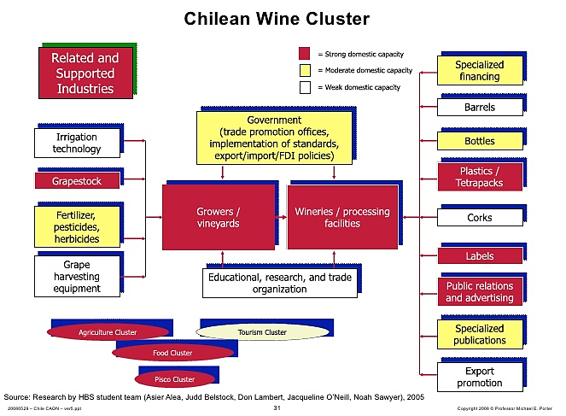
Cluster ecosystem

Slide 15
Clusters Dimensions
well-established | emerging
large and dense with a multitude of related industries | thin and smaller
manufacturing-oriented | service-oriented
science-driven | traditional sectors
strong external linkages and global reach | regional reach

Slide 16
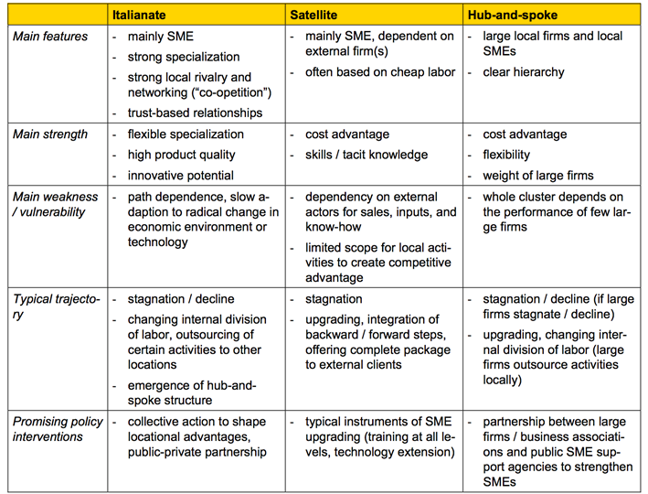
Clusters Typology

Slide 17
INTER-CLUSTERING
    An inter-cluster is an association of clusters within a specific interregional or transnational area and engaged in processes aimed at common strategic development.
    The objective is to promote synergies around high value added products and services, and thereby contribute to the emergence of European industrial projects.

Slide 18


Slide 19
Clustering rationale
Clustering is one of the key drivers of economic growth in localities, cities and regions
Productivity
Innovation
Economies of scale
Economies of scope
Business formation
Essential pillar of SMART specialization strategy

Slide 20
Productivity
Improved productivity within clusters is taking place in the following ways:
Inputs
by providing high quality, reliable and low-cost inputs
Access to Info
by easy, trustful and relatively cheap access to information
Facilitating complementarities
by facilitating complementarities between activities of cluster members
Access to public goods
by providing access to public or quasi public goods (below the full costs, e.g. trained labour)
Providing incentives
by providing stronger incentives and better performance measures than vertically integrated firms by reducing operational and transaction costs

Slide 21
Innovation
Clusters can contribute to innovation growth in the following ways:
Frequent info on buyers needs
by getting more frequent and clearer information on the buyers needs
Identifying new technology
by identifying new technological, operating and delivery opportunities
Direct observation
by direct observation of other firms
Access to new processes
by easier and faster access to new components and processes needed for innovation
Proximity of potential suppliers
by proceeding faster with innovations due to the proximity of potential suppliers and even their involvement in the innovation process
Availability of professionals
by the availability of new professionals needed for introducing innovations

Slide 22
Innovation
Proximity of potential suppliers
by proceeding faster with innovations due to the proximity of potential suppliers and even their involvement in the innovation process
Availability of professionals
by the availability of new professionals needed for introducing innovations
Utilising complementarities
by utilizing complementarities of local innovation partners
Reducing costs of innovations
by reducing operational and transaction costs of innovations

Slide 23

Economies of scale
ECONOMIES OF SCALE
Specialising production
Joint purchasing of raw materials
Joint marketing

Slide 24
Economies of Scope
Economies of scope effects (Jacobs externalities) suggest that heterogeneous activities placed in proximity lead to the greatest levels of value creation.

Slide 25
  Business Formations
Finally, clusters contribute significantly to new business formation by:
New Opportunities
Providing encouraging information about new business opportunities
Lower Barriers
Offering lower than in anywhere barriers to entry (and exit) with needed assets, skills and inputs in the cluster location
Lower Costs
Providing environments rich in social capital that lower transaction costs and risk premiums on capital

Slide 26
EUROPEAN CLUSTERS
In Europe, there are 2500 strong clusters, which account for:
39 %
of European jobs
55%
of European wages
2500 EU CLUSTERS
87 %
of all patents

Slide 27
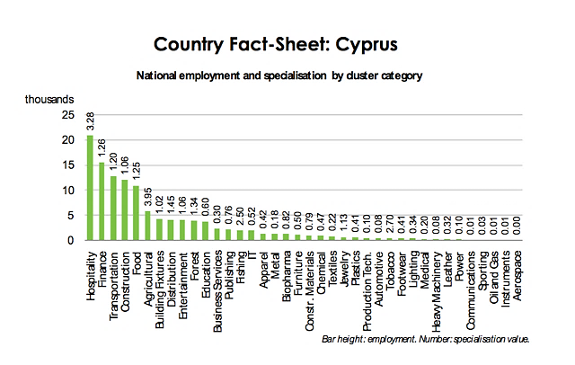
ROC Clusters

Slide 28
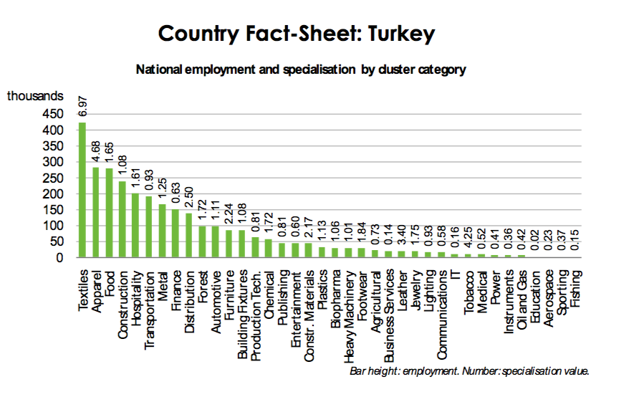
Turkey Clusters

Slide 29
CLUSTERS POLICIES IN TCC
SME STRATEGY
Objective 4: Strengthening the competitiveness of SMEs in both local and international fields.
4.1
Developing the technical, innovative and administrative skills of the SMEs
4.1.6
Consultancy services to SMEs on Business and Marketing Plan preparation & implementation, Management & Costing Systems, Loan Support, Strategic partner identification for joining clusters, etc.
4.4
Easing the access of SMEs to regional and other international markets
4.4.2
Determination and development of clusters and target sectors for SME’s development

Slide 30
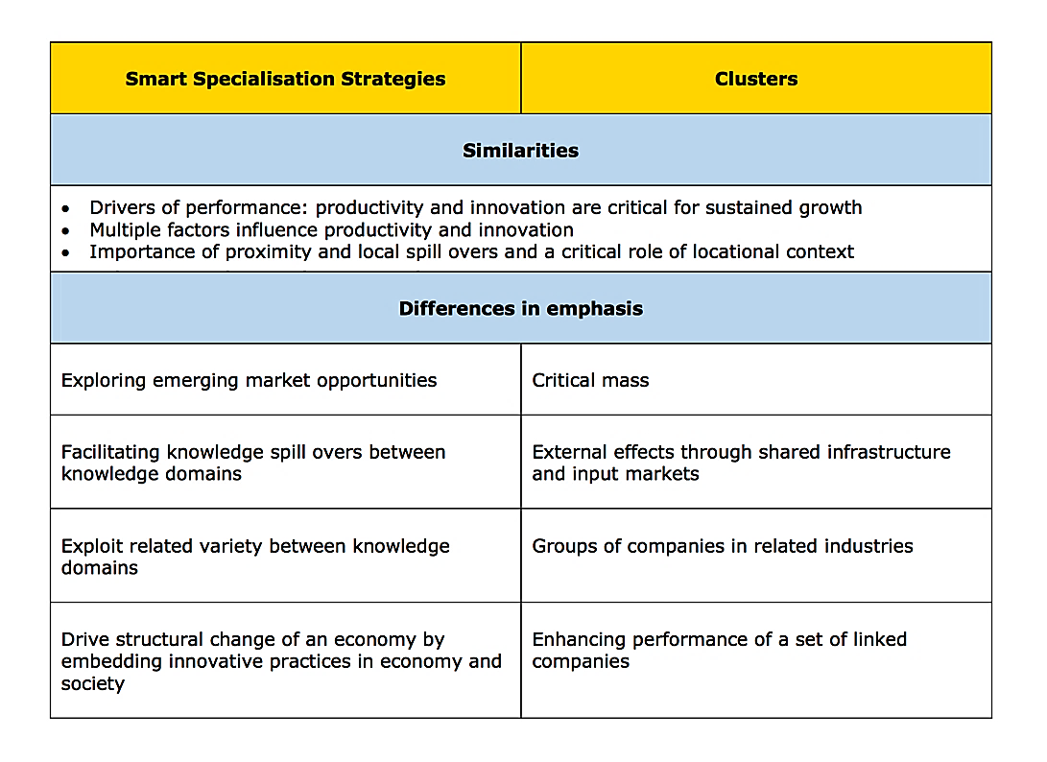
Clusters and S3
Source : The Role of Clusters in S3-EU-2013

Slide 31
Clusters and the Eu policies
Clusters are the chance for EU to catch up with the objectives of the Lisbon strategy by encouraging:
  competitiveness,
  innovations and
  sustainable development in the regions.
Synergy between cluster development and Eu structural funds

Slide 32
SESSION TWO

Slide 33


Slide 34
  Cluster life cycle
Agglomeration
Emerging cluster
Developing cluster
Mature cluster
Transformation
Source: Elisabeth Waelbroeck-Rocha based and SRI International (2001)

Slide 35
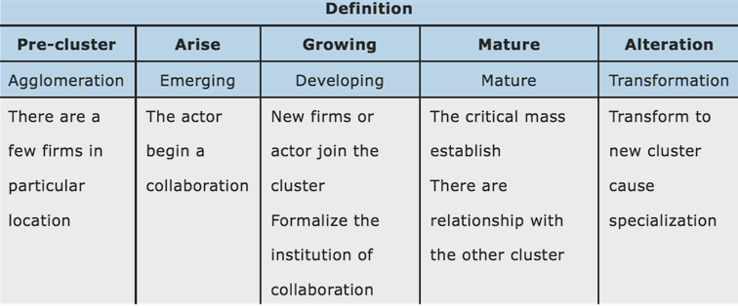
  Cluster life cycle

Slide 36
  Cluster life cycle
The Government
Roles; regulator, facilitator,
coaching, and technical assistance
Assessment to
Identify Phases of
Industrial Cluster
Life Cycle
Policy interventions in
accordance with
characteristics of each
phase of industrial cluster
life cycle
Industrial Cluster
Cluster evolve through their life cycle

Slide 37
Cluster: Formalisation, Governance and Funding
Informal cluster
Cluster organisation
Formalisation
Legal status (association)
Communication (logo & website)
Visibility
Possibility of funding
Uni./
Labs
Public actors (through cluster programmes)
Cluster organisation
Large companies
€
€
SMEs

Slide 38
Elements that influence the growth of clusters
Every Region has not the same chance to develop a certain cluster.
Key factors:
Technology transfer
Knowledge transfer
Skilled labour force in related industries
Agglomeration economies
Social infrastructure.
Social capital
Cluster development is more appropriate in areas where there is an existing diverse economic base
Notes:
Les clusters procurent 3 types d ’avantages concurrentiels :
1. Des gains de productivité
- s ’implanter au sein d ’une grappe peut assurer un meilleur accès ou moins couteux à des intrants (inputs) spécialisés tels que des composants, des machines, des services professionnels ou des travailleurs.
- cela permet également d ’accèder, à un moindre coût, à de grandes quantités d ’informations spécialisées de nature commerciale, technique, économique ou autre. La circulation de l ’information au sein d ’une grappe est également facilitée par la proximité ou l ’existence de relations personnelles. Les grappes transforment en biens publics des intrants qui, en leur absence, seraient coûteux. Il s ’agit, par exemple, des possibilités de recruter des salariés formés par des écoles locales ou de bénéficier de conseils d ’experts d ’institutions locales.
- Les grappes améliorent la productivité également en facilitant les complémentarités entre les activités des participants. Cette interdépendance peut être illustrée par le secteur du tourisme pour lequel l ’agrément ressenti par un tourisme pour un lieu ne dépend pas uniquement du site mais aussi du confort et du service des hôtels, restaurants, boutiques, moyens de transport ….
2. Des gains en matière d ’innovation
- la participation à des grappes permet aux enterprises confrontées à de multiples clients de percevoir très rapidement leurs besoins et leurs attentes.
- Les grappes peuvent aider à percevoir les besoins et les possibilités d ’innovation, mais elles peuvent aussi aider à les saisir en conférant une souplesse et une capacité d ’adpatation appréciable.
- Les contraintes mêmes de la grappe - telles que la pression concurrentielle - pousse à les entreprises à innover pour se distinguer.
3. Des gains en matière de création d ’entreprises
Les clusters favorisent la création d ’entreprises pour plusieur réaisons :
- tout d ’abord, l ’existence d ’un cluster signale en soi une opportunité. Ceux qui travaillent déjà dans la grappe perçoivent plus aisément les meilleures informations pour les opportunités.
- les barrières à l ’entrée au sein d ’une grappe sont plus basses qu ’ailleurs car il y est plus facile et moins coûteux d ’y asembler des moyens et des compétences.
- la possibilité de créer d la valeur ajoutée attire également les entrepreneurs extérieurs à la grappe qui sont attirés par la possibilité de créer davantage de valeur économique à partir de leurs idées et compétences.

Slide 39
Clusters and social capital
Defined as features of social organization such as networks, norms and social trust that facilitate co-ordination and co-operation for mutual benefit
Social capital embodied in modern knowledge, practical skills and positive attitude is the most valuable and creative component of innovation process

Slide 40


Slide 41
  Role of the government in cluster development
What is the role of the government in cluster development?
Role of the Government
Facilitate
Cluster Portfolio Management
Prioritise

Slide 42
Role of the government in cluster development
Public or private organization play a catalytic role in the setting up, expansion and management of the cluster.
Supporting the development of the necessary synergies and interactions, mentoring, providing services promoting visibility, international networking and penetration of products in global markets.
Free access to information and services to all potentially interested undertakings of the sector, members and non members of the cluster (open access one stop shop).
Dissemination of results.
Support for access to finance.

Slide 43
  Cluster policies
Cluster policies, are an expression of political commitment, composed of a set of specific policy interventions that aim to strengthen existing clusters and/or facilitate the emergence of new ones. They are to be seen as a framework policy that opens the way for the bottom up dynamics seen in clusters and cluster initiatives.

Slide 44
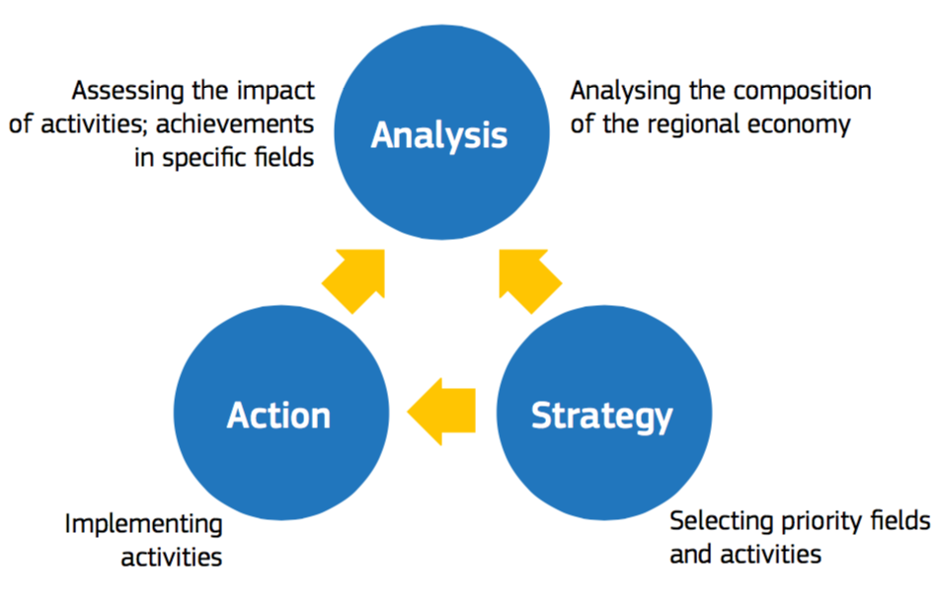
  Clusters Policy Cycle

Slide 45
  Indirect Policies
1. Securing macroeconomic and political stability (stable and sound policies, effective and transparent institutions);
2. Improving microeconomic capacities for development (education, infrastructure)
3. Establishing sustainable rules and incentives for competition (competition and tax policies, fair and effective legal system)
4. Facilitating cluster development and upgrading all clusters.
5. Developing and implementing a long-term action program to mobilize all cluster participants to systematically upgrade their capacities, thereby influencing the competitive position of their clusters.

Slide 46
  Direct Policies
Improve Cluster Dynamics
New Technology & Firm Growth
Inter-Actor Network Creation
Cluster Formation
New Technology
Organise seminars, meetings, workshops to facilitate the diffusion of technology within the cluster
Establish centres to develop and test new production technologies and processes
Create an observatory of technical trends
Establish hubs for technology transfer
Firm Growth
Support clusterbased incubators
Encourage entrepreneur networks
Provide business assistance
Launch marketing and image campaigns to attract new firms
Improve FDI incentives
Improve financing conditions for spin-offs through regularory changes or the set-up of special financeing mechanisms or investment funds
Cluster Analysis
Conduct a competence audit
Undertake a strategic study & analysis
Model and amplify systematic relationships
Conduct benchmarking analysis
Organise and disseminate information in the cluster
Actions for Engagement and Service Delivery
Create or formalise IFC and communication channels
Improve firms’ cluster awareness
Facilitate interaction between different areas of government and cluster actors
Cluster Marketing
Create brand for region
Actively promote cluster
Target inward investment
Networking
Form cross-agency cluster teams
Foster firm networks
Foster the sharing of personal networks
Facilitate external connections
Commercial Cooperation
Form export networks
Compile market intelligence
Coordinate purchasing
Establish technical standards
Joint R&D Projects

Slide 47
  Direct Policies
Improve Cluster Environment
Factor Markets
Cluster Basis
Specialised Labour Supply
Provide management & technical training
Use clusters as context for learning
Establish cluster skill centres
Support regional skills alliances
Attract talent to region
Specialised Capital Markets
Prioritise investments in cluster projects
Give incentives or set aside funds for multi-firm projects
Promote joint financing, the creation of special investment funds, or the provision of credit guarantees
Encourage mutualisation of risk across cluster actors
Improve access to and usage of natural resources
Legal Framework
Improve framework conditions
Evaluate competition policy
Infrastructure
Develop new or existing infrastructure through joint actions and new financing models
Social Capital
Foster the expansion of personal networks
Foster inter-firm communications and networks
S&T, R&D Framework
Mutualise the realisation or financing of research and development projects

Slide 48
  Cluster initiatives
Cluster initiatives are organized efforts to support the competitiveness of a cluster and thus consist of practical actions related to the capacity of these clusters to self­ organize and increasingly to pro­actively shape the future of the cluster.
They usually follow a bottom up approach, are implemented through a competitive process, and are often managed by specialized SME intermediaries, such as cluster organizations.

Slide 49
  Cluster initiatives principles
Microeconomic business environment rather than macro focus
Long term agenda to improve overall competitiveness of clusters rather than individual firms
Emphasis on regional and local areas
Improved networking among cluster firms, trust-building and enhanced dialogue to create spill overs
Seed money rather than large subsidies

Slide 50
  Cluster initiatives principles
Balanced input of resources from government and industry
Selection of clusters through a process of competition, implying a weaker form of winner-picking
Mix of competition and cooperation as driver of learning and innovation
Mix of SMEs and large firms
Partnerships across the “triple helix”: cluster firms, government and the academic community

Slide 51
Cluster initiatives
Public authority
Cluster initiative definition
Call for proposals
Cluster selection/
labellisation
Cluster funding
Evaluation
Answer
selection
€
selection
€
Outputs (projects, innovation, employement…)
Cluster organisations

Slide 52
  Cluster initiatives
1st Step
Call for expressions of interest (- submission of short proposals including a mapping exercise in the thematic field of the emerging cluster, identification of the clustering needs, cluster identity)
2nd Step
Call for submission of 5 - years business plans
3rd Step
Financial support for the implementation of a 2-years pilot programme of joint activities.

Slide 53
  Cluster initiatives
Phase 0: Preparatory phase – Mapping - Identification of Clustering Needs.
Phase 1:
Implementation of a Pilot Programme of Joint Activities.
Phase 2:
Expansion – achievement of critical mass

Slide 54
  Cluster initiatives
Target groups: networks including at least 10 business firms) and at least 1 research/academic organisation.
Open to all sectors/ thematic fields,
No limitation as to the type of the facilitator (private or public sectors)
Min. 10 Businesses
Min. 1 Academic/ Research Org.
All sectors/thematic fields
Public or Private Facilitator
Cluster Initiative

Slide 55
Monitoring
Driver – Networks and partnerships
Driver – Innovation and R&D
Driver – Human resources
Number of partnership arrangements
Number of co-operation agreements
Number of networking events
Number of joint research activities
Extent of social capital
R&D employment
R&D expenditure
Number of business spin-outs
Number of patents applies for
Number of innovation awards
Numberof new products/ processes adopted
Number of vacancies
Educational attainment rates
Number of defined qualifications
Extent of measured skills gaps
Driver – Networks and partnerships
Net employment change
Increase in GVA/GDS
Growth of existing businesses
Number of firm within the cluster
Levels of investment
Levels of profitability
Value of exports

Slide 56

Negative impacts of support policies
Negative externalities
Adverse selection
Moral Hazard

Slide 57
Negative impacts of support policies
Negative externalities can arise via the provision of information and advice services to SMEs. Typically, negative externalities occur when the take-up of information or advice leads to a change in the behaviour of that SME in ways that are harmful to other businesses.
Adverse Selection is the process by which the price and quantity of goods or services in a given market is altered due to one party having information that the other party cannot have at reasonable cost.
Moral Hazard is situation where there is a tendency to take undue risks because the costs are not borne by the party taking the risk.

Slide 58
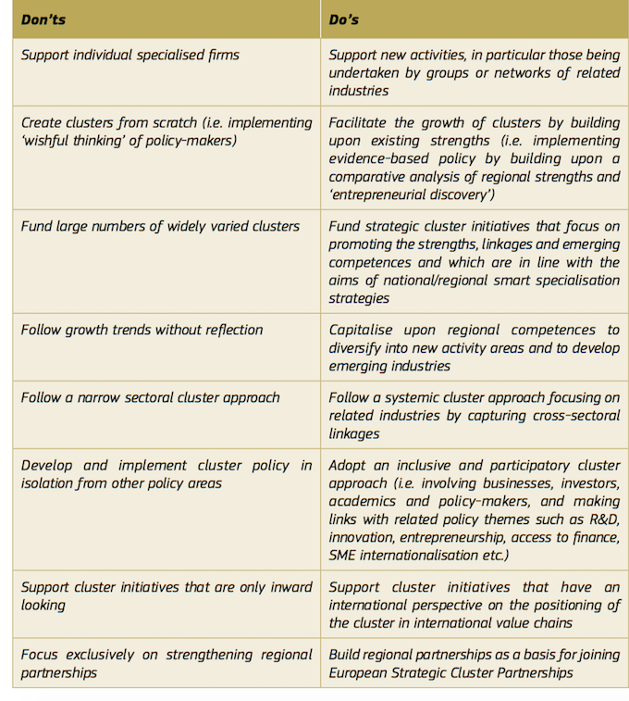
Policies Best Practices

Slide 59

SESSION THREE

Slide 60
Sector selection for cluster support policies
The systemic and strategic vision needed for modern cluster development and policy can be provided by the concept of SMART specialization whereby a region undergoes an entrepreneurial search and discovery process to find out what it does best, its sectorial competitive advantages and related innovation opportunities, and works towards developing joint roadmaps and aligning investment agendas.

Slide 61
Sector selection for cluster support policies
Old techniques
Heavy reliance on quantitative data which are scarce
Ex post-not capturing trends
Not inclusive of many competitive drivers such as:
  Community attitudes to foreign investment,
  entrepreneurship,
  research competence,
  business risk acceptance,
  adaptability to changes in technology,
  regional labor flexibility,
  quality of life issues,
  the development of social capital.

Slide 62
Sector selection for cluster support policies
Location quotients
Used for measuring the extent of a region’s specialization or concentration in an industry cluster
LQ = fraction of regional employment in industry cluster
fraction of national employment in industry cluster
If the region employs 15% of its workforce in the industry cluster, while the nation employs 10% then;
LQ = 0.15 / 0.10 =1.5
Since LQ exceeds one,
the fraction of the workforce employed in the region’s cluster exceeds the fraction employed in the cluster at the national level

Slide 63
Sector selection for cluster support policies
INDUSTRY CLUSTERS BUBBLE CHART
Hypothetical Data
Mature
5
Star
1
LQ in 2007
10
-10
Transforming
0
Emerging
% chg in LQ 2001-2007

Slide 64
Sector selection for cluster support policies
Regional SWOT Analysis problems
It does not apply equally to every sector of the regional economy
Many of the micro-factors in different industry sectors go are cancelled out in SWOT analysis. It is the cumulative effect of factors contributing to the competitiveness of specific industries that are responsible for giving a region its competitive advantage

Slide 65
Sector selection for cluster support policies
Multi-Sector Qualitative Analysis: A new Tool for Evaluating Regional Competitiveness and Design Cluster Based Strategies for Regional Development
Multi-sector Qualitative Analysis
Cluster Based Strategies
Regional Competitiveness

Slide 66
Sector selection for cluster support policies
MSQL
This approach examines the relationships between selected economic variables (or criteria) and different industry sectors and requires recording information for selected industries concerning a range of factors and criteria, classified into various characteristics as follows:
Regional and sector core competencies
Economic-linkage possibilities
Trade possibilities
Regional economic and industry risk

Slide 67
Sector selection for cluster support policies
MSQL
Critically, analysis is not restricted by the availability of quantitative information, and can therefore explore the relationships between a series of selected economic and other variables, and selected industries or sector.

Slide 68
Sector selection for cluster support policies
MSQL
These relationships are recorded using descriptive or numeric scores in a matrix format .The scores are summed vertically and horizontally, then graphed to produce indices showing the significance of the variables upon different industry sectors, and the industry sectors most influenced by the criteria used in the evaluation.
For each variable is possible to calculate a comparative sectorial index.

Slide 69
Sector selection for cluster support policies
MSQL
Industry Sectors
Evaluation Criteria
A B C ∑
X 0 1 0 1
Y 1 3 0 4
Z 0 0 2 2
∑ 1 4 2
Matrix

Slide 70
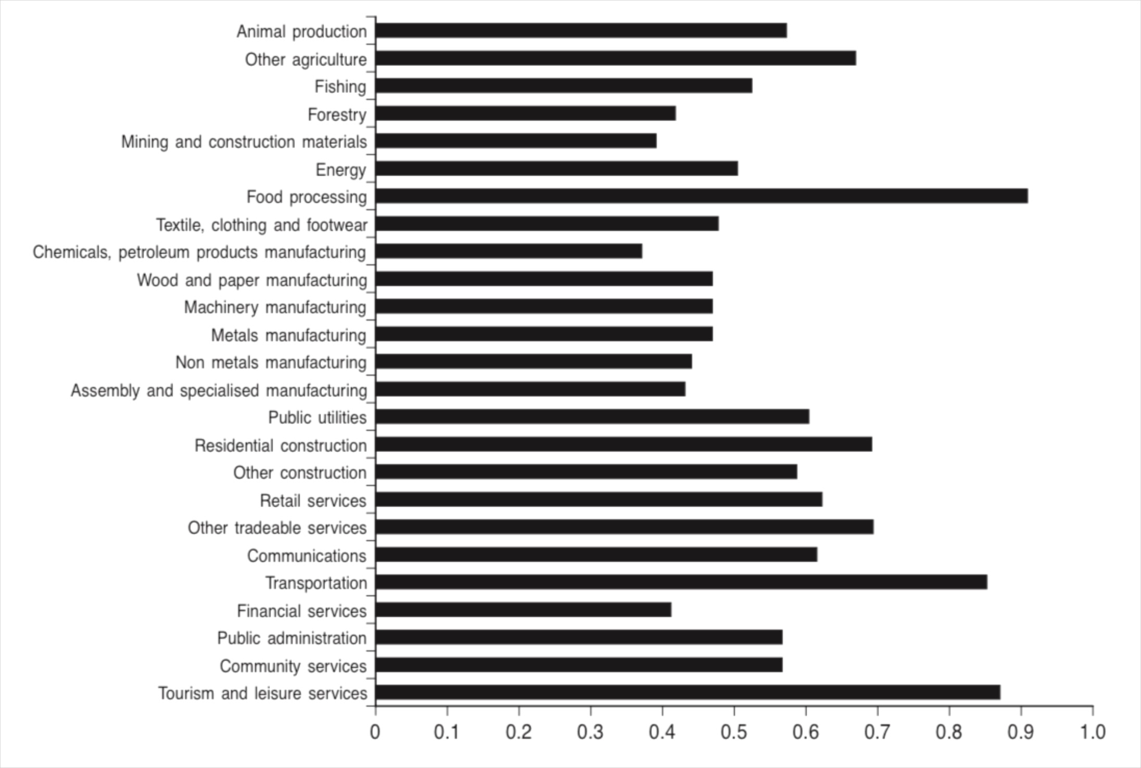
Sector selection for cluster support policies

Slide 71
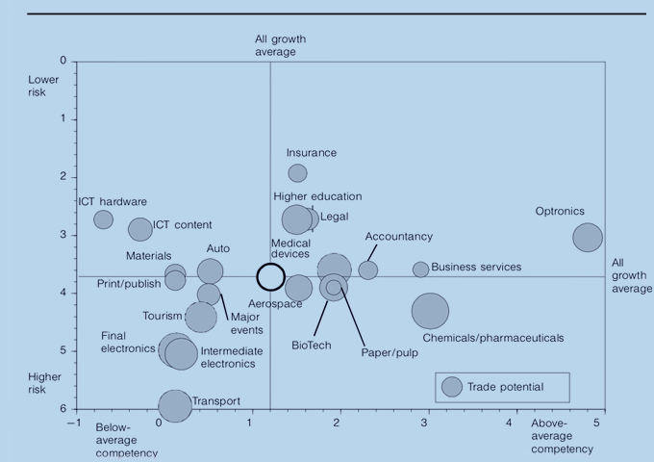
Sector selection for cluster support policies

Slide 72
Sector selection for cluster support policies
Regarding the data collection for preparing the matrix, the use of expert panels is recommended because it the most cost effective and timely participation technique. Expert panels for each industry consist of a cross section of specialists, government officials, business and community leaders ,some of which operate externally to the region.
The experts will be asked to fill in the matrix, which will be then be completed.

Slide 73
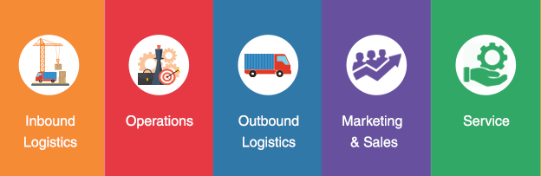
Sector selection for cluster support policies
VALUE CHAIN ANALYSIS

Slide 74
Sector selection for cluster support policies
Value chain Analysis Rationale
While the MSQA indicates the sectors strategic for the TCCc economic development, the sectorial value chain analysis will indicate for each sector the competences needed for the SMEs and clusters to be successful and productive.
The end product will be a gap analysis which will identify the scope and the range of services that need to be delivered to contribute to the development of the local economy.

Slide 75
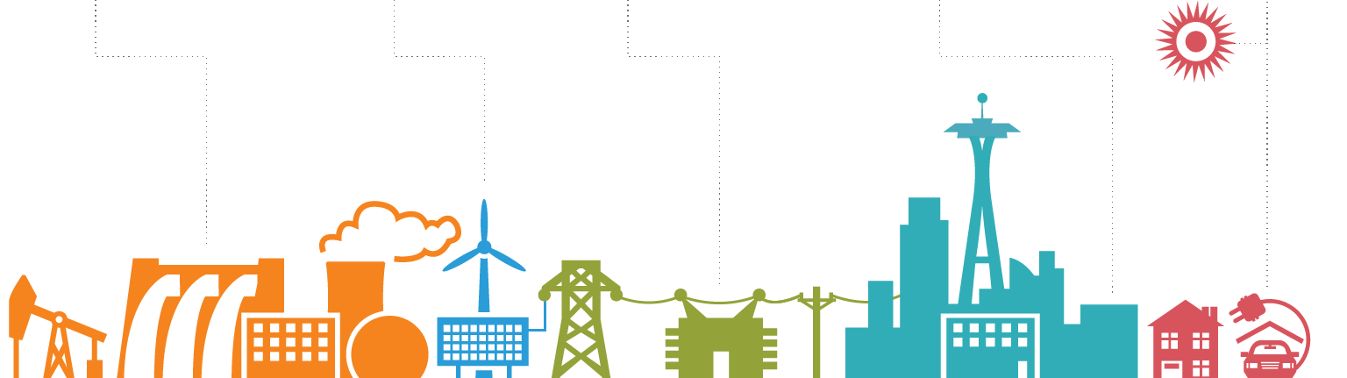
Sector selection for cluster support policies
VALUE CHAIN ANALYSIS
Utility
Value chain analysis plays a key role in understanding the need and scope for systemic competitiveness.
Upgrading the performance of individual firms in a region may have little impact if they are inefficient. If the chain cannot be competitive, the success of individual firms is compromised. Therefore, taking a systemic approach is key to sustaining the competitiveness of the chain and the MSEs operating within it.

Slide 76
Sector selection for cluster support policies
    Value Chain Analysis Methodology
Mapping
actors,
functions &
relationships
End Market
Analysis
Collect
Data
Analyze
Data
Wet
Findings/
Develop
Action Plan
Opportunities
and their
constraints

Slide 77
Sector selection for cluster support policies
Data Collection
Desk Review
Semi structured interviews

Slide 78
Sector selection for cluster support policies
Analysis of Opportunities and Constraints Using the Value Chain Framework
The factors affecting performance of the chain are:
end markets
business environment
horizontal linkages
supporting markets
value chain governance
inter-firm relationships

Slide 79

Sector selection for cluster support policies
BSPs Gap analysis

Slide 80
Clusters Development
Step 1 – Cluster Selection
Step 2 – Cluster Review
Step 3 – Establish the Leadership Group
Step 4 – Develop Cluster Vision and Mission Statements
Step 5 – Identify strategic milestones
Step 6 – Action Plan
Step 7 – Institutionalization
Step 8 – Long Term Activities

Slide 81
Cluster Selection
Short List
Export potential
Significant potential impact on the local economy
Support from founders
Priorities
Current exports, and possible growth; current and potential employment; number of firms
Cluster critical mass
The infrastructure in place
The degree of interaction/networking between firms
Geographic boundaries of the cluster

Slide 82
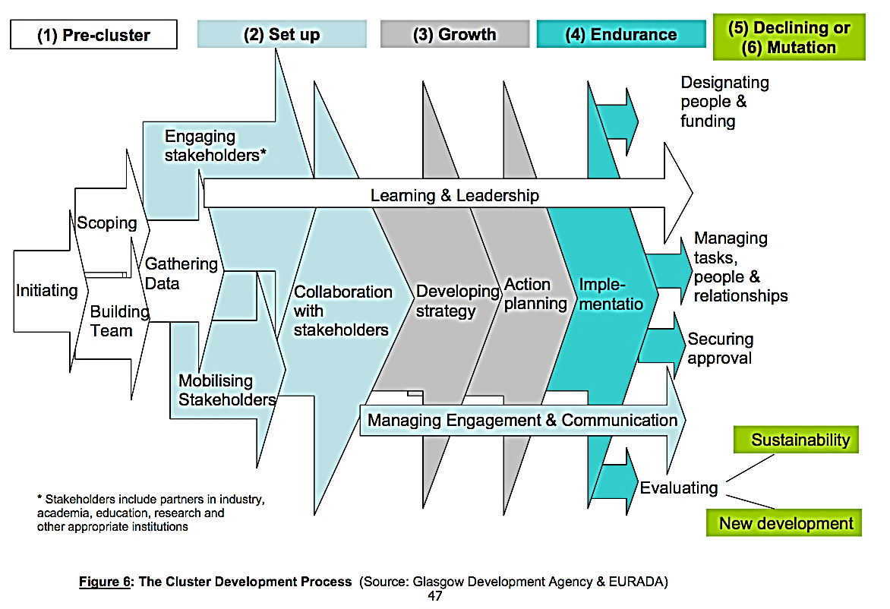
Cluster Development

Slide 83
Cluster Review
To identify the size and structure of the local cluster and define its role in the local economy
To introduce the clustering process to the key stakeholders, securing their ongoing support.
supporting
local
initiatives
acting
together
deciding
together
consultative
informative

Slide 84
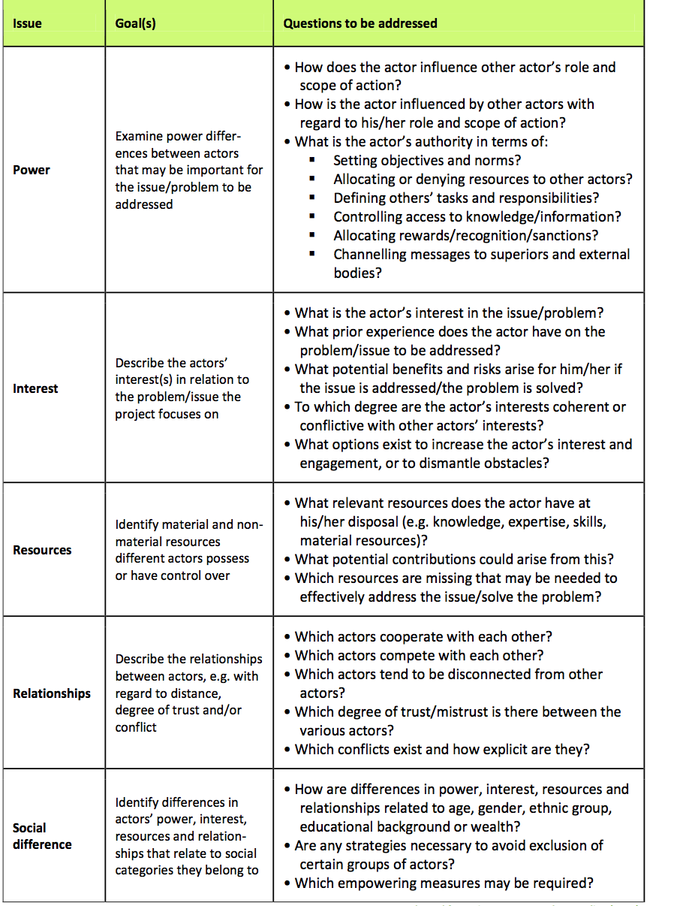
Cluster Review

Slide 85
Establish the Leadership group
The BSO employed cluster facilitator plays a leading role in establishing this group by identifying a group of senior stakeholders who have a wide set of skills necessary for cluster management, and convince them of the advantages of participating in the cluster.
The role of the Cluster Facilitator will be to enhance local economic growth through bringing together businesses in strategic groupings with a focus on developing collaborative engagement at both network and cluster levels.

Slide 86
Establish the Leadership group
The facilitator needs to have:
the personal skills to motivate and empower senior cluster stakeholders;
the ability to build long term relationships, and to motivate when the going gets hard;
close working knowledge of the activities represented by senior stakeholders;
knowledge of the clustering process, and of the resources available to support clustering initiatives;

Slide 87
Developing the Cluster’s Vision and Mission Statement
Based on the findings of the initial review, the facilitator will propose the cluster vision and mission statement in agreement with the Leadership Group.
The mission will be different from the vision in that the former is the cause and the latter is the effect; a mission is something to be accomplished whereas a vision is something to be pursued for that accomplishment.
Mission
Vision

Slide 88
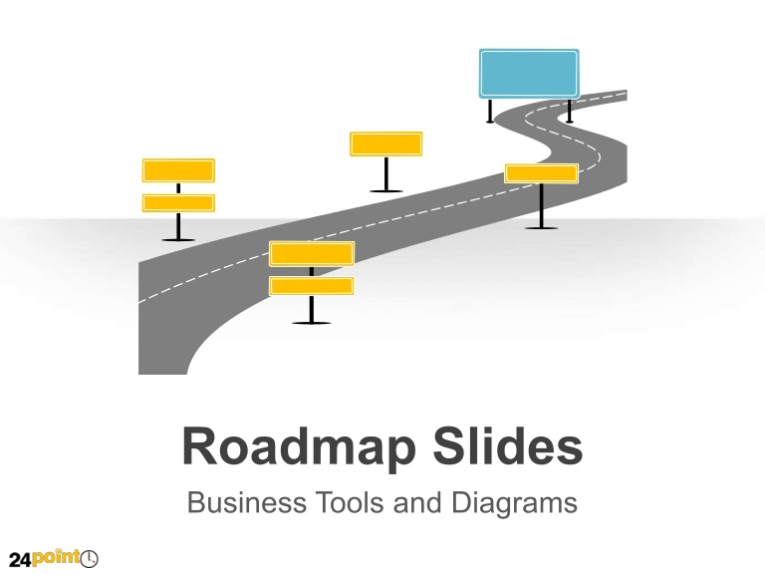

Identify Strategic Milestones
After the vision and the mission statements are established, the next step is to define and prioritise the strategic milestones that need to be achieved through workshops.
GOAL
Milestone 4
Milestone 2
Milestone 3
Milestone 1

Slide 89
    Action Plan
The objective of this step is to start developing an action plan for each of the milestones identified by:
Describing the activity
Detailing the expected results
Allocating the resources that are needed
Identifying the people with the best skills for each activity to deliver the particular results

Slide 90
Institutionalization
After the initial support and involvement from BSOs, it is important that the cluster finds its own formal and permanent organisational structure in the long-term, with its own financial and institutional sustainability.
At this stage, the BSO leaves the task to continue cluster development within the Leadership Group to the facilitator.

Slide 91
    Long-term Activities
After the cluster formal organisational structure and the operational teams have been established it is possible to dedicate some resources to long-term activities such as:
Benchmarking
Branding
Corporate Identity Promotion
Strategic Networking

Slide 92
Resources
European
Cluster
Observatory
European
Excellence
EU initiative
Statistics & Services
Appropriate skills
Policy incentive & practical tool
Policy
Recommen-dations
European
Cluster
Policy Group
European
Cluster
Alliance
TACTICS
Oseo
Visibility
INTERREG Networks
Cluster Innovation Platforms (CIP)
Regions of Knowledge networks (FP7)

Slide 93
European Cluster-Support Policy Projects
  Projet Cluster- Excellence.eu - European Cluster Excellence Initiative (Pro INNO Actions) identification of performance indicators, quality management approach, case studies, development of training material
  Projet TACTICS (INNO Nets) cluster policy. Support and further expand the European Cluster Alliance, and contribute to the development of better cluster policies and practical tools in Europe.
  ECA (European Cluster Alliance (PRO INNO) Design better cluster policies and raise the excellence of cluster programmes. issue de 4 projets INNO Nets (88 regions de clusters)
  Cluster IP (Europe INNOVA) : facilitate transnational cooperation between cluster org at a practical level pr dvper ou tester better innovation support tools pour les clusters. IP = innovation platform
  European Cluster Observatory (Europe INNOVA) : provide statistical analysis and mapping of clusters across €, facilitate partnering of cluster org and cluster firms by acting as a fully-fledged information service
  European Cluster Policy Group composed of high-level experts looking into future challenges for cluster policies (€ + national level)

Slide 94
European Cluster-Support Policy Projects
  Brain Flow (Brain Flow and Knowledge Transfer fostering Innovation in Border Regions) exchange best practices and experiences on interregional level in order to develop and introduce new or improved instruments to avoid or minimize brain-drain and simultaneously foster brain-gain.
  CREA.RE (Creative Regions), creative economy
  SMART + (Mini-Programme for Entrepreneurship and SME Innovation), focuses on SMEs as the key force for the transition of economy based on traditional industries towards the knowledge-based economy.
  POOLING4CLUSTERS (Best shared services for regional cluster initiative needs), analyse and share experiences regarding value added services provided by DAs in order to help CIs to be more efficient
  Know-Man (Knowledge Network Management in Technology Parks), regional development and spatial innovation policies, knwoledge networks management

