Slide 1

BRANDING

Slide 2
Expectations
What are you expecting to learn from the training today?

Slide 3
Today’s Topics
Understanding the language of branding
Coming up with a brand name
Crafting the brand identity
Sending signals to your customer’s brain with colours and typography
‘The 22 Immutable Laws of Branding’

Slide 4
What is a brand?

Slide 5

Brands live in our head

Slide 6
Definition of a Brand
‘A name, term, sign, symbol or design, or a combination of them intended to identify the good and services of one seller or group of sellers and to differentiate them from those of the competition.’*
*The American Marketing Association

Slide 7
What is a brand?
The source of a promise to the customer
The source of a relationship with the customer
The unique source of products and services
The single concept you own inside the mind of the prospect
The sum of each customer’s experience with your organisation

Slide 8
What is a registered trade mark?
'A trade mark may consist of any signs capable of being represented graphically, particularly words, including personal names, designs, letters, numerals, the shape of goods or of their packaging, provided that such signs are capable of distinguishing the goods or services of one undertaking from those of other undertakings.‘*
*Article 2, Directive 2008/95/EC of the European Parliament and of the Council

Slide 9
What is a registered trademark?
In practice it means...
Your trade mark is the symbol your customers use to pick you out. It distinguishes you from your competitors.
You can protect and build upon your trade mark if you register it. In some countries, you can also get protection even if your trade mark is not registered, as long as it is used. However, you are well advised to register it in order to obtain the best protection.
The only condition imposed on a registered trade mark is that it must be clearly defined; otherwise neither you nor your competitors will be certain of what it covers.

Slide 10
What is brand equity?
Brand equity is the commercial value of all associations and expectations (positive and negative) that people have of an organization and its products and services due to all experiences of, communications with, and perceptions of the brand over time.
Parameters of brand equity*:
  Brand awareness
  Percieved quality
  Brand associations
  *David Aaker’s brand equity parameters

Slide 11
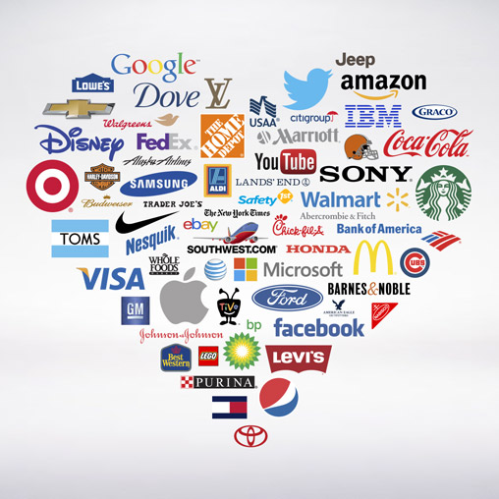
What is brand image?
Brand image is the general impression resulting from all experience with knowledge of the brand. It is how consumers perceive the brand.

Slide 12
What is brand associations?
Brand associations are anything a consumer associates with the brand in his or her mind.
These can be:
  Organisational
  Product related
  Symbolic
  Personified
  Retail experience

Slide 13
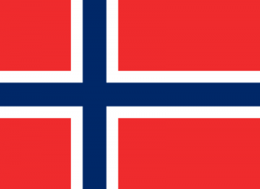
What does this remind you?
Notes:
You are in a cosmetics store and you are traveling slowly through the shelves. You can see a Norwegian flag on a package from among the products you have browsed. This is a visual element that greatly increases the awareness level of the brand. You do not remember why, but suddenly Norwegian Fishermen appear before your eyes. A voice you can not describe says you should trust this product. Then you slide your eyes down in white packaging. You suddenly read a very readable character and read the "Norwegian Blackberries Nutritious Lotion". You do not know how Norwegian Blackberries is; Perhaps you have never heard of it; Even if you are not sure whether it is useful. The same sound, however, says that the Norwegian Blackberries is a very fruitful fruit, and lotions made from it moisturize the skin of Norway's harsh climate perfectly. You are about to be convinced in a few seconds. Then you see in the band just below this phrase "Increase the moisture level of the skin 3 times". There is an asterisk above the three-fold expression, but who cares! You are already convinced. Then you are stuck in a blackberry visual below. This visual is not really different from any blackberries, but you say "this is a Norwegian Blackberry". So you are satisfied that you have met a Norwegian Blackberry. Your eyes continue to slip down and eventually you meet the logo of the brand. The word under the logo puts the final point: it has been developed together with dermatologists. You stretch out your hand and pick up the product and throw into the basket.

Slide 14
What is brand positioning?
Brand positioning is the way the brand is perceived within a given competitive set in the consumer’s mind.
Ideally, it is a function of the brand’s promise and how the brand compares to other choices with regards to:
  Quality
  İnnovation
  Perceived leadership
  Value
  Prestige
  Trust
  Safety
  Reliability
  Performance
  Convenience
  Customer service
  Social responsibility
  Technological superiority

Slide 15


What is brand positioning?
Relevant differentiation is the most important aspect of brand positioning.
Brand essence, promise and personality are a part of brand positioning.
The management team works to make sure what exists in the ‘mind of the consumer’ and the intended brand positioning, matches.

Slide 16
What is brand essence?
Brand essence is the heart and soul of a brand - the fundamental nature and quality, summed up in one-two words. A brand essence is a promise of specific values and benefits, one that has meaning and relevance to users.
Typically brand essence and the slogan are not the same.
Strong brands have well-defined, easily grasped, simply obvious essences.
Some examples:
  Nike: Inspirational
  Disneyworld: Magical
  Volvo: Safety

Slide 17
Criteria for brand essence
Single-minded One word is ideal. Maybe two. More than two words indicates that the brand has no focus. As a brand (by design) delivers a unique experience, having no focus makes for a weak brand.
Unique The essence of a brand is how it is different from competitors in the same category. e.g., if Apple (and its products) is friendly and approachable, then it is claiming that its competitors are not.
Experiential The essence captures what the consumer feels during an encounter with the brand. e.g., ‘Driving a Volvo makes me feel that my family is safe.’?
Consistently delivered If the proposed essence is not consistently experienced (e.g. if a trip to Walt Disney World isn’t magical), then it isn’t the essence. Can your organisation deliver?
Authentic The essence must be credible or the brand will be rejected. To find out what consumers believe about your brand, ask them. It’s okay for the brand essence to be aspirational, but only if your customers believe you can deliver on the promise.

Slide 18
Tips to remember on brand essence
Brands are more than just product names. If you have a brand that delivers emotional benefits to customers, your loyalty and margins will be much higher.
In today’s competitive world, it is hard to maintain a performance edge through innovation for long. When you lose this edge, the emotional attachment of your brand will keep loyalty until your next breakthrough innovation.
Brands need to be crystal clear in their expression of their essence, reinforcing consistently across time, media and geographies in order to establish their essence in the consumer’s mind.

Slide 19
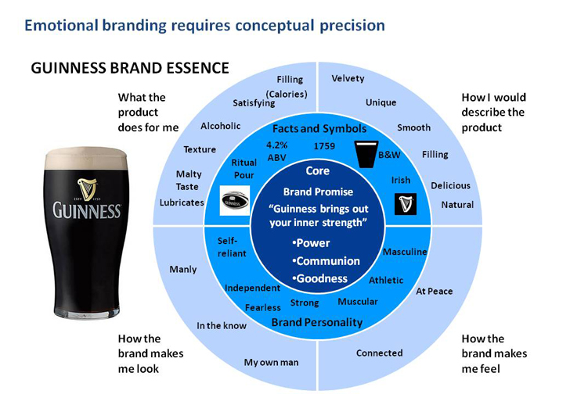

Slide 20
What is brand promise?
A brand must promise differentiated benefits, relevant and compelling to the customer, to be successfully positioned in the market. A brand promise must:
  Address important consumer needs
  Leverage your organisation’s strengths
  Give yourself a competitive advantage through differentiation
  Inspire, energise, mobilise your audience
  Drive every organisational decision, system, action and process
  Manifest itself through your products and services

Slide 21
The simple truth of branding
Brand is not an icon, a slogan or a mission statement. It is a promise.
First you find out through research, what promises your customers want from a company like yours.
Then you look at your competition and decide which promise would give you the best competitive advantage.
This is the promise you make and keep, in every marketing activity, action, corporate decision and every customer interaction.
You promote it internally and externally.

Slide 22
Five points driven by the brand promise
Mission, Vision, Strategy
Brand
Promise
Values &
Behaviours
Communication
Products & Services
Operation, system,
logistics

Slide 23
What is brand personality?
It is assigning human personality traits/ characteristics to a brand so as to achieve differentiation.
Brand personality refers to adjectives that describe the brand such as;
fun, kind, sexy, safe, sincere, sophisticated, cheerful, old fashioned, reliable, progressive, etc.
How consumers perceive a brand’s personality is often discovered through qualitative research by asking people to describe the brand as if it were a person or an animal.

Slide 24
Brand Identity
Brand identity is a combination of visual, auditory, and other sensory components that create recognition, represent the brand promise, provide differentiation, create communications synergy, and are proprietary.
Components of a brand’s identity:
  Names and nomenclature, logotypes, symbols, typography and other graphic devices,
  Distinctive shapes and colours, brand voice and visual style, sounds, jingles and other mnemonic devices,
  Theme lines or slogans and characters that are uniquely associated with a brand
  Textures, scents, flavours, and other sensory elements

Slide 25
Logo type
Brand mark
Core
elements
of Brand
Identity
Colour
Typography
Photography
Illustration
Icons
Grid
Character
Slogan
Voice
Guidelines

Slide 26
Merchandising
Froo It
Coca Cola
Handsome Coffee Roasters

Slide 27
 | Brand Identity | Brand Image
1 | Brand identity develops from the source or the company. | Brand image is perceived by the receiver or the consumer.
2 | Brand message is tied together in terms of brand identity. | Brand message is untied by the consumer in the form of brand image.
3 | The general meaning of brand identity is “who you really are?” | The general meaning of brand image is “How market perceives you?”
4 | It’s nature is that it is substance oriented or strategic. | It’s nature is that it is appearance oriented or tactical.
5 | Brand identity symbolizes firms’ reality. | Brand image symbolizes perception of consumers
6 | Brand identity represents “your desire”. | Brand image represents “others view”
7 | It is enduring. | It is superficial.
8 | Identity is looking ahead. | Image is looking back.
9 | Identity is active. | Image is passive.
10 | It signifies “where you want to be”. | It signifies “what you have got”.
11 | It is total promise that a company makes to consumers. | It is total consumers’ perception about the brand.

Slide 28
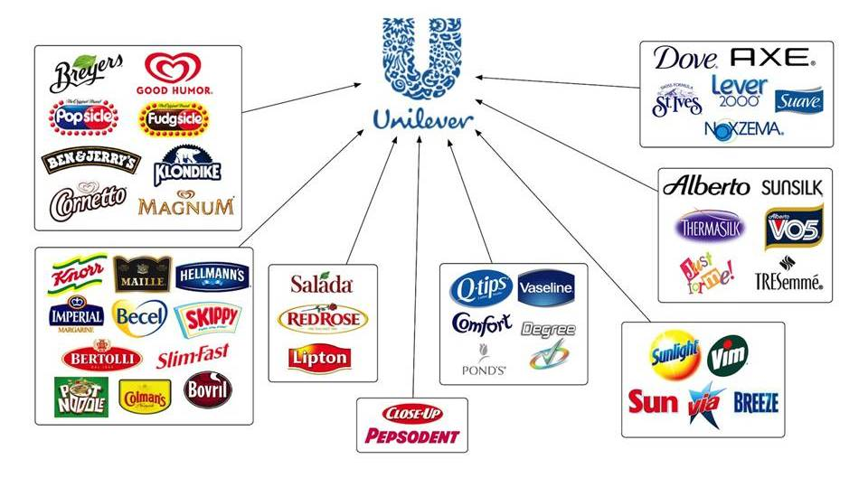
Brand Portfolio
Brand portfolio is the mix of brands and subbrands owned by an organisation.

Slide 29

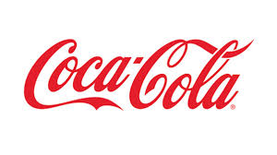


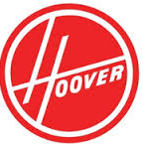
Brand Architecture/ Structure
This is the brand’s family tree.
It shows how the brand organises the various named entities within the portfolio and how they are related.
These may be:
  Corporate brand
  Master brand
  Parent brand
  Sub-brand
  Endorsed brand

Slide 30
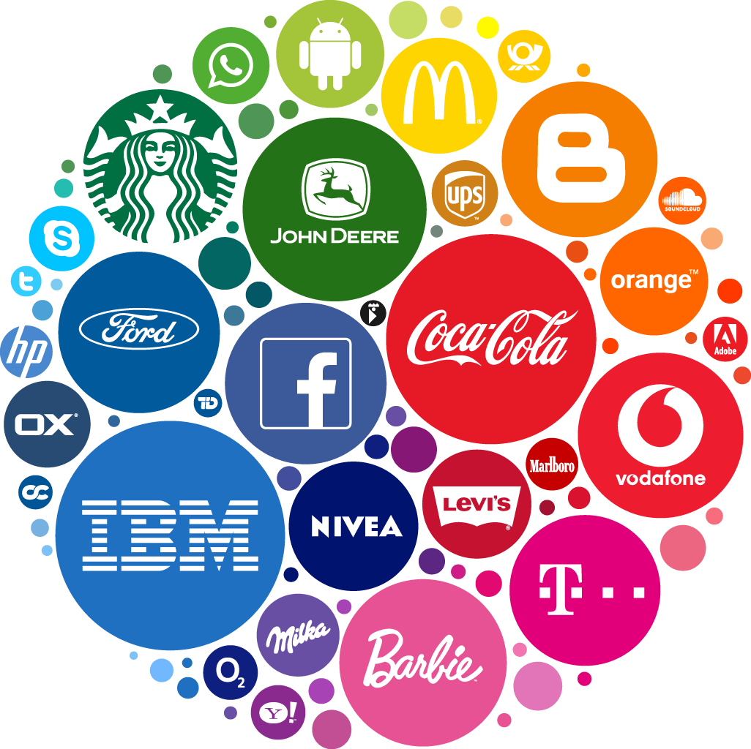
Summary of terms
Brand
  Registered trademark
Brand equity
  Brand image
  Brand associations
Brand positioning
  Brand essence
  Brand promise
  Brand personality
Brand Identity
  Brand portfolio
  Brand architecture

Slide 31

Coffee Break

Slide 32
Important points to remember
Know your audience
Identify your target market, not just by demographics but also by tastes.
Everything counts
Keeping your brand consistent is key. All elements is part of the concept tailormade for your target audience.
Be memorable
Standing out from the crowd is the only way to get your brand noticed.

Slide 33
Crucial Steps Before Naming Your Brand
1. Decide if you will consult with experts
2. Come up with a goal for your brand name
3. Brainstorm different names
4. Check for trademark violations
5. Create a visual concept for each idea
6. Make the final decision
How much are you willing to invest? Can your team come up with a brand name?
What makes you stand out from other businesses?
The best brand names evoke an emotional connection and impart logical information at the same time. Try different angles.
Make sure to check, not to clash with other brand names.
Once you have settled on a few different options, create boards with designs for each brand name. Seeing the visual concept will help you decide.
After determining your new brand name, you should pair your brand naming strategy with a marketing strategy to attract the right crowds.

Slide 34
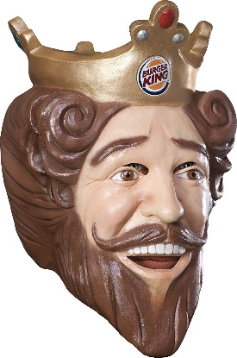
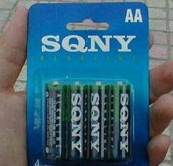

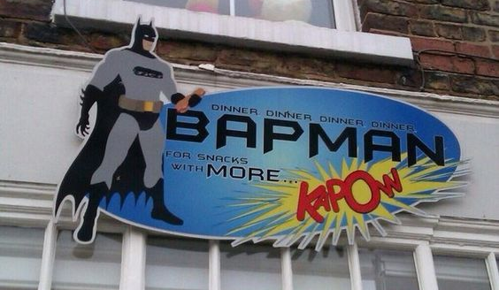
Avoiding a bad brand name
1- Using the wrong image for representation
2- Imitating others
3-Using puns only funny to you
4-Misspellings or strange spellings

Slide 35
Brainstorming a name in 6 steps
Find 15 words each for steps 1-5
Competitors
  What name/s are the competitors using to brand their products?
Value
  Which words express the most important thing your product does for its users? Use verbs.
Literal
  Which words come to mind when thinking about your product’s physical characteristics?
Abstract
  Which words related to feelings or emotions best express your product’s key functions?
Combinations
  How could you combine any of the words in points 1-4 to form a new name?
Synonyms
  Find synonyms for the best 25 words that you came up with in points 1-4. Spend more time on your strongest ideas.

Slide 36
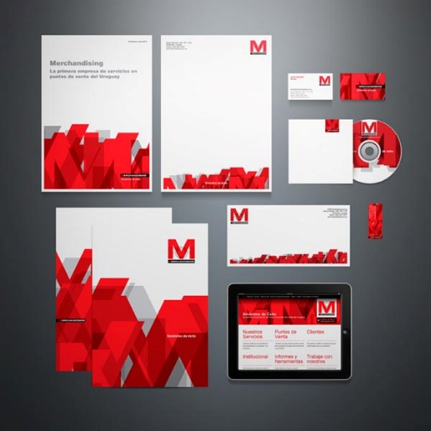
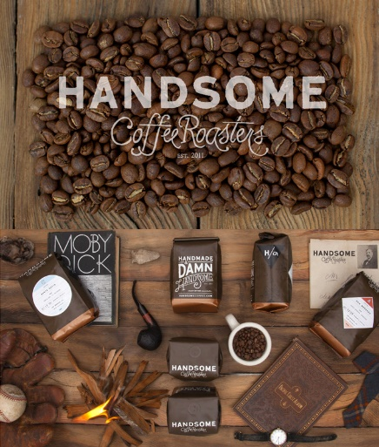
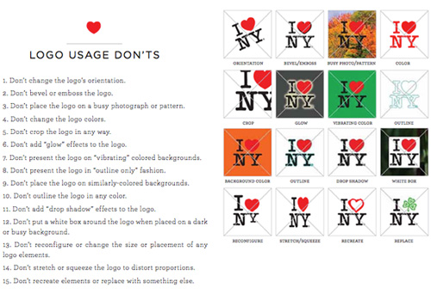
Steps for crafting a visual identity
Logo, identity & guidelines
Logo
Identity system (The visual language around the logo)
Style guidelines (Logo usage rules, typeface system, colour palette, layout guidelines for creation of marketing material)

Slide 37
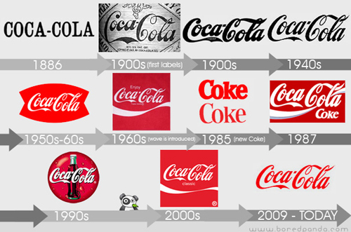
Steps for crafting a visual identity
Monitoring and Rebranding
The brand lives and interacts with customers
Check for:
  target audience shifts over time
  Evolvement of the market
  Changes in products/services
When rebranding, maintain familiarity and consistency to be remembered.

Slide 38
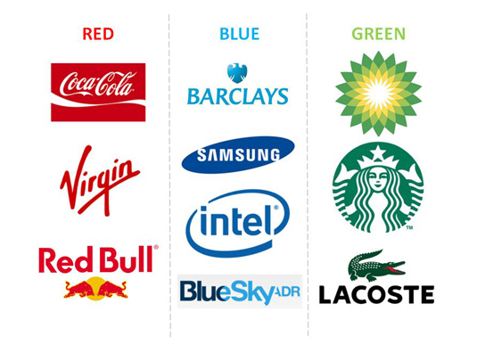
Signalling your customer’s brain with colours
The human mind is highly responsive to visual stimuli, and colour is one of the major defining factors in that response.
RED implies passion, energy, danger or aggression; warmth and heat. It has also been found to stimulate appetite, which explains why it is used in so many restaurants and food product logos. Choosing red for your logo can make it feel more dynamic.
ORANGE is often see as the colour of innovation and modern thinking. It also carries connotations of youth, fun, affordability and approachability.

Slide 39
Signalling your customer’s brain with colours
GREEN is commonly used when a company wishes to emphasise their natural and ethical credentials, especially with such products as organic and vegetarian foods. Other meanings ascribed to it include growth and freshness, and it's popular with financial products too.
BLUE is one of the most widely used colours in corporate logos. It implies professionalism, serious mindedness, integrity, sincerity and calm. Blue is also associated with authority and success, and for this reason is popular with both financial institutions and government bodies.

Slide 40
Signalling your customer’s brain with colours
YELLOW requires cautious use as it has some negative connotations including its signifying of cowardice and its use in warning signs. However it is sunny, warm and friendly and is another colour that is believed to stimulate appetite.
PURPLE speaks to us of royalty and luxury. It has long been associated with the church, implying wisdom and dignity, and throughout history it has been the colour of wealth and riches.
BLACK is a colour with a split personality. On the one hand it implies power and sophistication, but on the other hand it is associated with villainy and death. More mundanely, most logos will need a black and white version for use in media in which colour is not available – and there is currently a trend for bold monochrome logos and word marks.

Slide 41
Signalling your customer’s brain with colours
WHITE is generally associated with purity, cleanliness, simplicity and naiveté. In practical terms, a white logo will always need to stand in a coloured field to make it show up on a white background. Many companies will choose to have a coloured version and a white version of their logos; for example, the Coca-Cola word mark appears in white on its red tins and brown bottles but is used in red when needed on a white background.
BROWN has masculine connotations and is often used for products associated with rural life and the outdoors.
PINK can be fun and flirty, but its feminine associations means it is often avoided for products not specifically targeted at women.

Slide 42
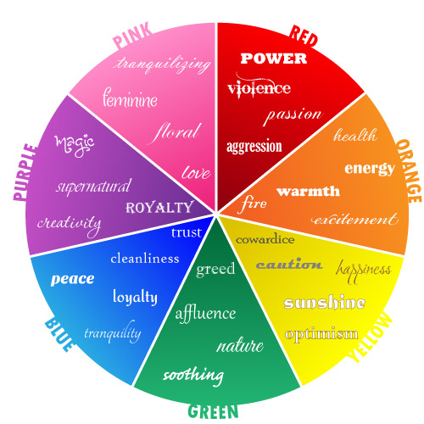
Signalling your customer’s brain with colours

Slide 43
Signalling your customer’s brain with typology
Typefaces give the text personality, allowing the reader to identify with it more effectively.
Choosing the wrong typeface ruins the design and the message.
Ask these questions while choosing your typeface:
  Is it legible enough?
  How much emphasis do you need?
  Is it appealing to your audience? (Personality of the font)
  Does it represent your brand and goals?
Sağlam Muhasebe
Sağlam Muhasebe
HSBC Bank
Happy Anaokulu

Slide 44
Signalling your customer’s brain with typology
Typology checklist:
Pairing
Size
Hierarchy
Leading
Tracking
Colour

Slide 45
The 22 Immutable Laws of Branding
The Law of Expansion: The power of a brand is inversely proportional to its scope.
The Law of Contraction: A brand becomes stronger when you narrow its focus.
The Law of Publicity: The birth of a brand is usually accomplished with publicity, not advertising.
The Law of Advertising: Once born, a brand will die unless kept alive with advertising.

Slide 46
The 22 Immutable Laws of Branding
The Law of the Word: A brand should strive to own a word in the mind of the consumer.
The Law of Credentials: The crucial ingredient to the success of any brand is the claim to authenticity.
The Law of Quality: Quality is important to have, but brands are not built by quality alone. Quality, or perception of quality resides in the mind of the buyer.
The Law of Category: A leading brand should promote the category, not the brand.

Slide 47
The 22 Immutable Laws of Branding
The Law of the Name: In the longer run, a brand is nothing more than a name.
The Law of Extensions: The easiest way to destroy a brand is to put its name on everything.
The Law of Fellowship: In order to build a category of product, a brand should accept the presence of other brands.
The Law of Generic: One of the fastest routes to failure is giving a brand a generic name.

Slide 48
The 22 Immutable Laws of Branding
The Law of the Company: Brands are brands. Companies are companies. There is a difference.
The Law of Subbrands: What branding builds, subbranding can destroy.
The Law of Sibling: There is a time and place to launch a second brand.
The Law of Shape: A brand’s logotype should be designed to fit the eyes. Both eyes.

Slide 49
The 22 Immutable Laws of Branding
The Law of the Colour: A brand should use a colour that is opposite of its major competitor.
The Law of Borders: There are no barriers in global branding. A brand should know no borders.
The Law of Consistency: A brand is not built overnight, success is measured in decades not years.
The Law of Change: Brands can be changed, but only infrequently and only very carefully.

Slide 50
The 22 Immutable Laws of Branding
The Law of the Mortality: No brand will live forever. Euthenasia is often the best solution.
The Law of Singularity: The most important aspect of a brand is its single-mindedness; the singular idea or concept that you own inside the mind of the propect.

Slide 51
THANK YOU

